Slide 1
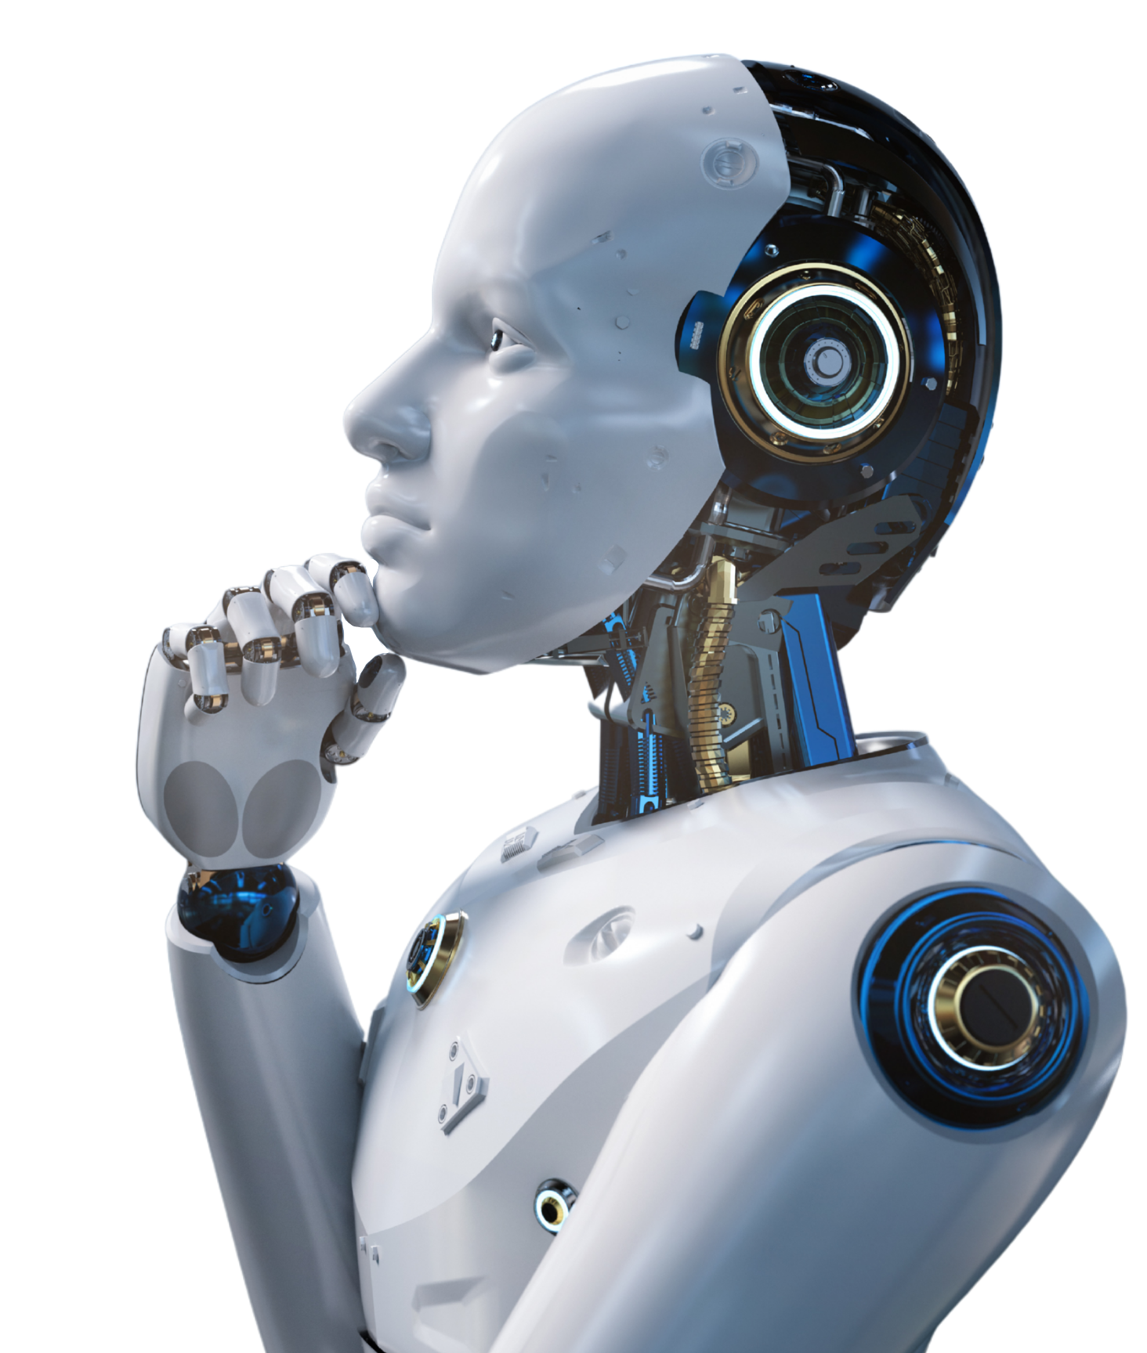
Demystify Generative AI for Everyone
-- Anshu Pandey

Slide 2

Introduction
Anshu Pandey
AI Consultant & Trainer
MCT, WCT, 15+ certifications in AI & Analytics from Microsoft, IBM & AWS
12+ years into Technology Consulting, Data Science, ML, AI

Slide 3
Session1: Foundations and Tooling of Generative AI

Slide 4
Session1: Foundations and Tooling of Generative AI
GenAI Foundations: Generative AI Landscape & GenAI Ecosystem
Generative AI v/s Discriminative AI
Generative AI Tools & Framework
Working of Generative AI
LLM Selection

Slide 5
Generative AI Foundations

Slide 6
Where Have You Seen GenAI in Action?
Take 2 minutes and think: where have you personally seen Generative AI in action—at work or in daily life? Then we’ll share a few examples.

Slide 7
Where Have You Seen GenAI in Action?
Writing: “I use ChatGPT or Gemini to draft emails, summarize documents, or create outlines.”
Coding: “GitHub Copilot / CodeWhisperer suggests code as I type in VS Code.”
Content: “Marketing uses tools like Jasper, Midjourney, or DALL·E to generate ad copy and images.”
Customer service: “Our support chatbot now answers free-form questions, not just FAQ buttons.”
Productivity: “Meeting tools generate minutes, action items, and summaries automatically.”
Notes:
“Which of these examples feel closest to your day-to-day work?”
“Where do you feel GenAI is already adding value?”
“Where do you feel skeptical or worried?”

Slide 8
AI Landscape
Artificial Intelligence (AI)
systems that perform tasks that normally require human intelligence (planning, perception, language, reasoning).
Machine Learning (ML)
algorithms that learn patterns from data instead of being explicitly programmed.
Deep Learning (DL)
a subset of ML using multi-layer neural networks to learn complex representations.
Generative AI (GenAI)
deep learning models that learn the structure of data and then generate new content that resembles the original data (text, images, code, audio, video).

Slide 9
AI Landscape
Layer | Question it answers | Simple example
AI | “Can a machine act intelligently?” | Rule-based fraud detection
ML | “Can it learn from data?” | Credit-risk scoring from customer history
Deep Learning | “Can it learn complex patterns automatically?” | Vision model detecting defects in images
Generative AI | “Can it create new content?” | Model drafting an email or generating UI code

Slide 10

Generative AI
What is Generative AI?
Generative AI refers to a subset of artificial intelligence that focuses on creating new content, such as images, text, music, or even code, by learning patterns from existing data.
Unlike traditional AI, which primarily analyzes and predicts based on input data, generative AI generates new, original data by understanding the underlying structures and relationships within the input.
It uses techniques like Generative Adversarial Networks (GANs) and Variational Autoencoders (VAEs) to create content.

Slide 11
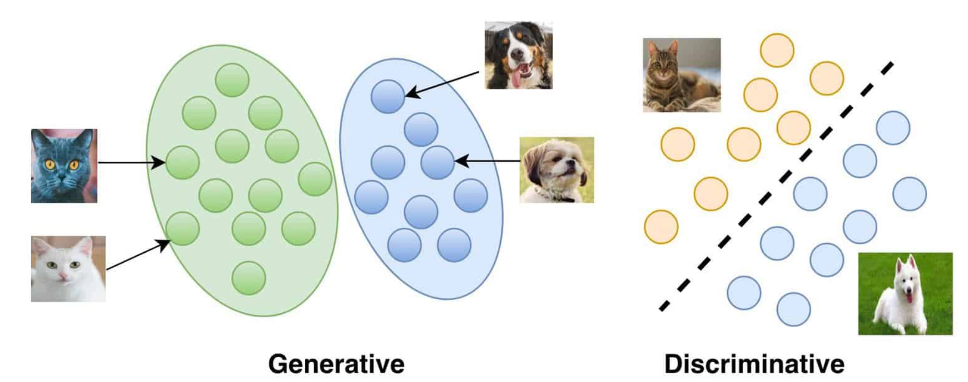
Discriminative AI vs Generative AI
Discriminative AI
Generative AI
Primary Goal
It identifies and separates various types of data or categories.
It creates new examples of data that are similar to the input.
The dashed line is the decision boundary learned by Discriminative AI to separate data points (circles) for cats (yellow) and dogs (blue).
Generative AI creates new data similar to its input; the circles suggest potential new images, like a cat, modeled after its training data.

Slide 12
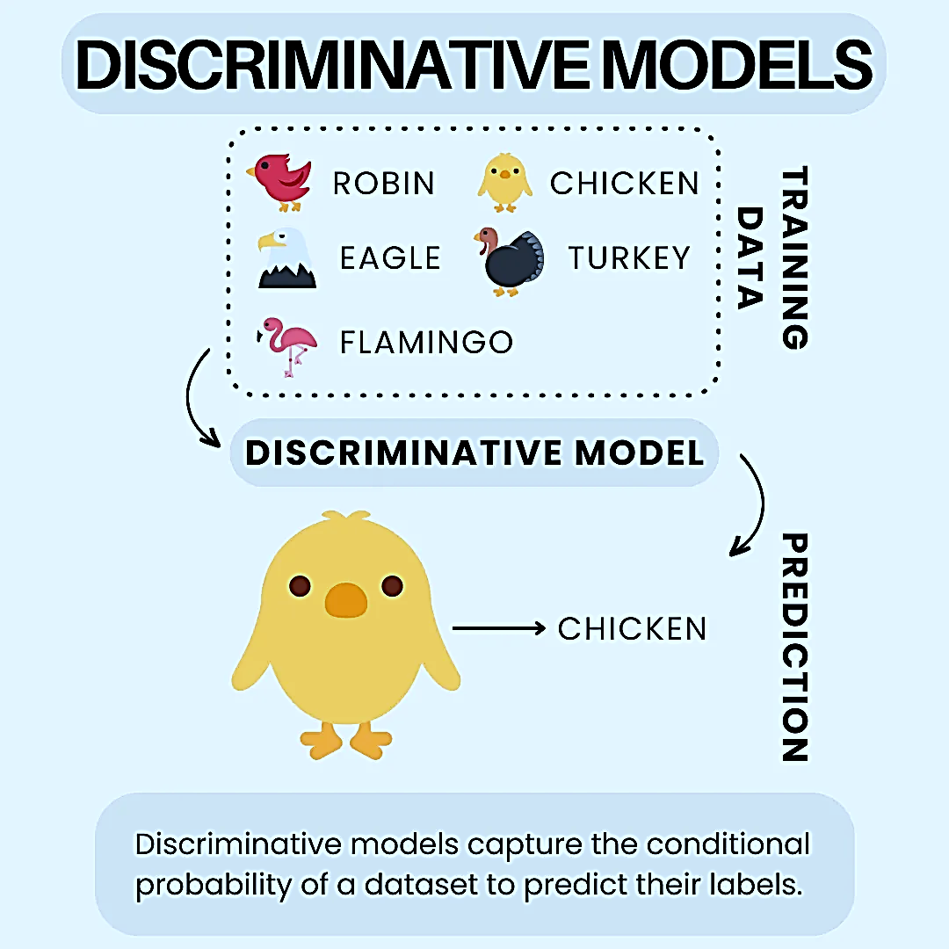
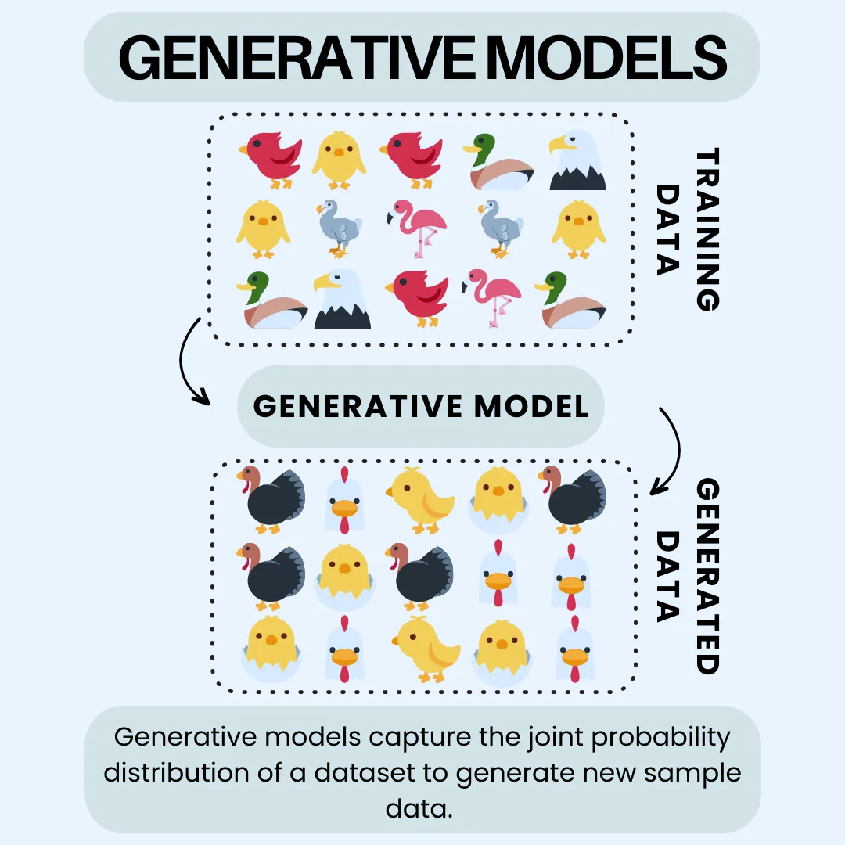
Discriminative AI vs Generative AI
Discriminative AI
Generative AI
Nature of Output
Discriminative AI makes decisions or labels data, typically by classifying or predicting numerical values.
Generative AI, on the other hand, produces new content that mimics its training material, like images, text, or audio.
The image shows a Discriminative AI model that has been trained on various birds. It takes an image of an unknown bird and predicts its species, labeling it as a "CHICKEN".
The image illustrates a Generative AI model that, after learning from a variety of bird images, generates new, unique bird images that resemble the training data.

Slide 13
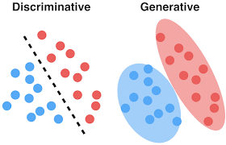
Discriminative AI vs Generative AI
Discriminative AI
Generative AI
Learning Approach
Discriminative AI focuses on understanding the distinctions between categories, learning how to separate them
Generative AI, meanwhile, learns how the training data is structured and distributed, aiming to create similar data.
The image illustrates a Discriminative AI model using a dashed line to separate red and blue dots, showing how it learns to distinguish between two different categories.
The image shows a Generative AI model with blue and red dots within two ovals, illustrating its ability to create data that resembles each distinct group.

Slide 14
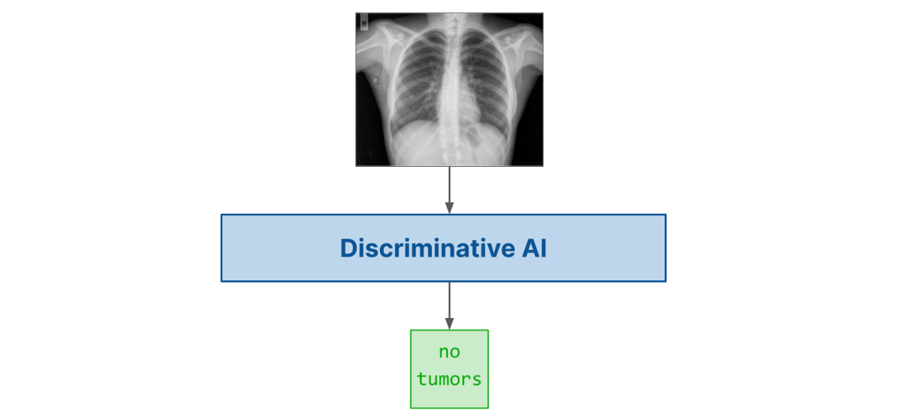
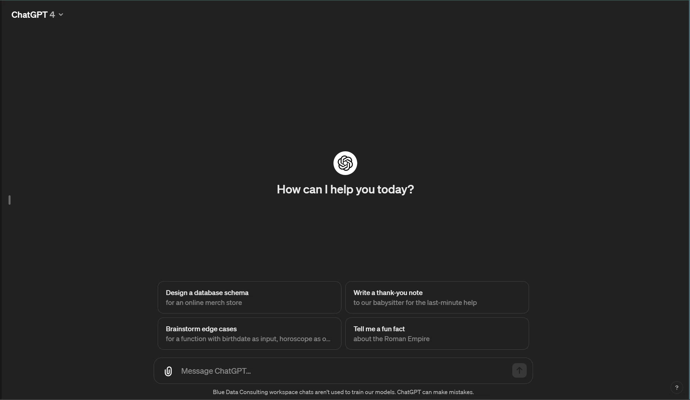
Discriminative AI vs Generative AI
Discriminative AI
Generative AI
Use Cases
Discriminative AI is used for tasks like identifying images, detecting spam, and diagnosing medical conditions.
Generative AI, conversely, is utilized for creating images and sounds, writing text, and generating data.
The image shows Discriminative AI being used to analyze a chest X-ray and diagnose that there are no tumors present.
This explains that GPT is a Generative AI model that creates text from the prompt given by the user.

Slide 15
Discriminative AI vs Generative AI
Discriminative AI
Generative AI
Use Cases
Credit-card fraud detection (fraud / not fraud).
Predicting customer churn (will churn / will not churn).
Defect detection from sensor signals (defective / non-defective).
Generating realistic but synthetic transaction data for testing.
Drafting personalized retention emails for high-churn-risk customers.
Creating maintenance playbooks and troubleshooting guides from raw logs.

Slide 16
Approach to implement AI Solutions
Approach 1: Build it from Scratch (Science Focused)
Data Collection
Data Processing, cleaning
Model Training
Model evaluation, optimization
Model Packaging, deployment
Integrate with Enterprise App
Approach 2: Implement using what is available (Engineering focused)
For any use case, look at pre-trained models,
Pick an open source, or proprietary model, test it
Integrate it with enterprise app

Slide 17
Tasks in Generative AI

Slide 18
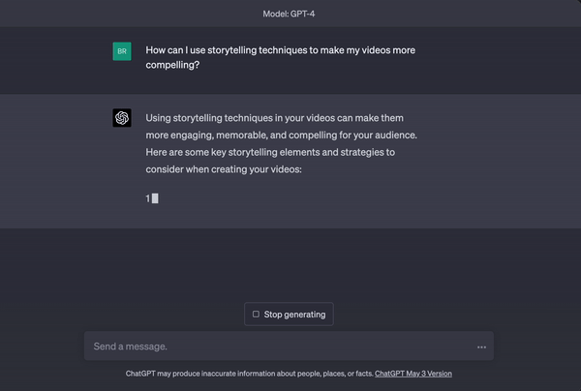







Generative AI
Text Generation
These models are designed to generate human-like text based on a given prompt or input.
They are often used in chatbots, content creation, summarization, and language translation.
Example Models: GPT-5 (OpenAI), Gemini, Llamma, Groq
Applications
Chatbots (e.g., ChatGPT)
Automated content generation (e.g., blog posts, articles)
Text summarization
Language translation

Slide 19
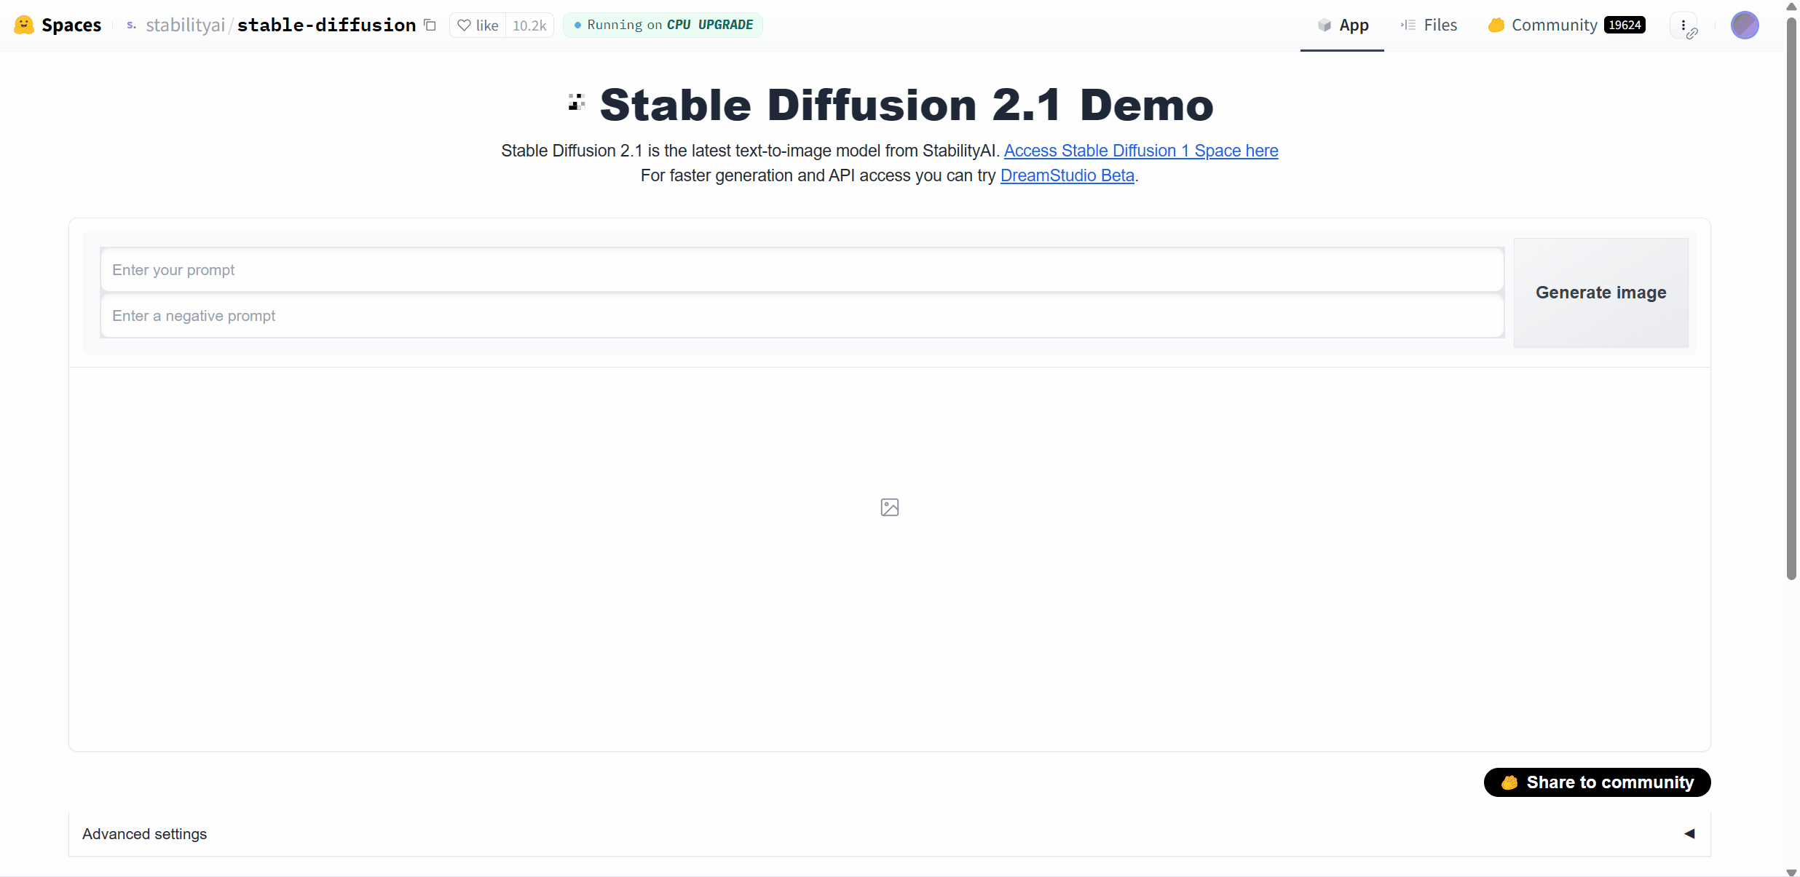




Generative AI
Image Generation
These models generate images based on textual descriptions or other input types.
They are used in creating realistic images or artwork from text prompts, and image enhancement tasks.
Example Models: DALL·E 3 (OpenAI), Stable Diffusion, MidJourney., Imagen
Applications
Creating digital artwork.
Generating realistic images from text (e.g., "A sunset over a mountain").
Enhancing or modifying existing images.
Generating illustrations for advertisements or product descriptions.

Slide 20

Generative AI
Video Generation
These models generate video content from text, images, or even other videos.
They are used in creating synthetic video data for training AI, or generating new video content from prompts.
Example Models: Sora, DeepMinds DreamerV3, Synthesia.
Applications
Video creation from script or description.
Automated video editing or enhancement.
Deepfake generation (creating realistic but synthetic videos).
Creating personalized avatars or virtual characters in videos.
Prompt: A young man at his 20s is sitting on a piece of cloud in the sky, reading a book.

Slide 21
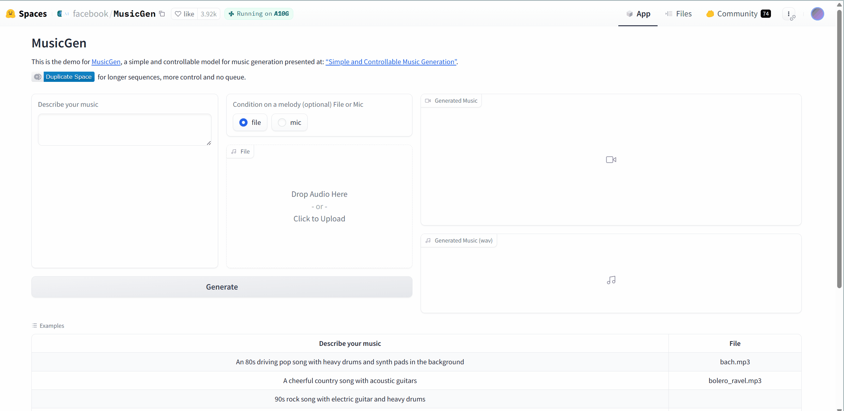
Generative AI
Audio Generation
These models generate audio from text or other audio prompts.
They can create human-like speech, music, or sound effects.
Example Models: WaveNet (Google), GPT-3 + Tacotron (OpenAI + Google), Jukedeck (for music).
Applications:
Text-to-speech (e.g., virtual assistants like Siri).
Music generation (e.g., creating soundtracks).
Voice synthesis and cloning.
Audio-based content creation for podcasts, voice-overs, or audiobooks.

Slide 22
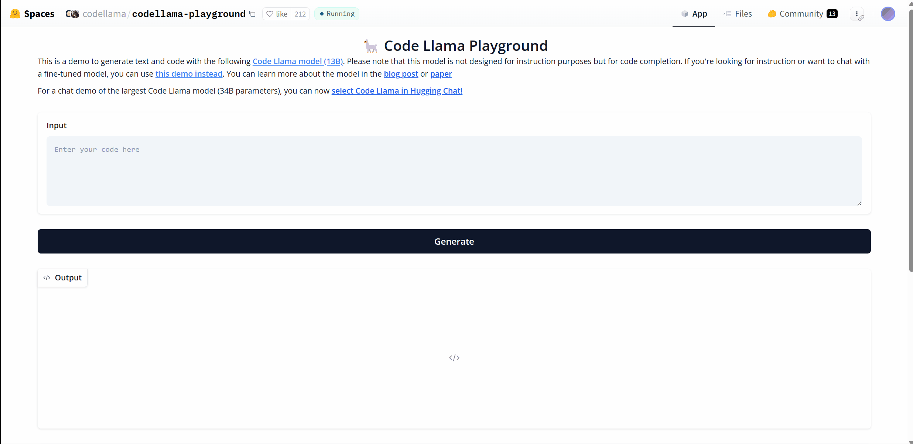
Generative AI
Code Generation
These models are designed to generate code based on user inputs like natural language descriptions or partial code.
They are used in software development for generating boilerplate code, scripts, or even complete software solutions.
Example Models: Codex (OpenAI), GPT-3 (OpenAI for code), TabNine.
Applications
Auto-completion in code editors.
Generating code snippets from user requirements.
Assisting in writing algorithms or solving coding problems.
Automated bug fixes and code refactoring.

Slide 23
Generative AI Ecosystem
Model Providers
Develop different models, train and provide it as opensource or as a paid service.
OpenAI, Google Brain, Anthropic, Stability AI, DeepSeek, Mistral
Infrastructure Providers
Provide GenAI focused infrastructure solutions to train, finetune, host models.
Hardware: NVIDIA, AMD
Cloud: AWS Bedrock, Azure AI Foundry, Google Vertex AI
Model as a service: chatgroq, Together AI
Engineering Tool Providers
Provide software tools, frameworks to develop, manage, maintain GenAI Apps
Development: Langchain/Langgraph, llamaindex, crewAI, Autogen, Google ADK, haystack
No Code: Flowise, n8n, langflow
Ops: Langfuse, langsmith, agentops, mlflow
Solution Providers
Develop end solutions for enterprises or end users
Service Providers:
Cognizant, Accenture
TCS, Wipro
Products:
ChatGPT, Perplexity, Windsurf, Copilot

Slide 24
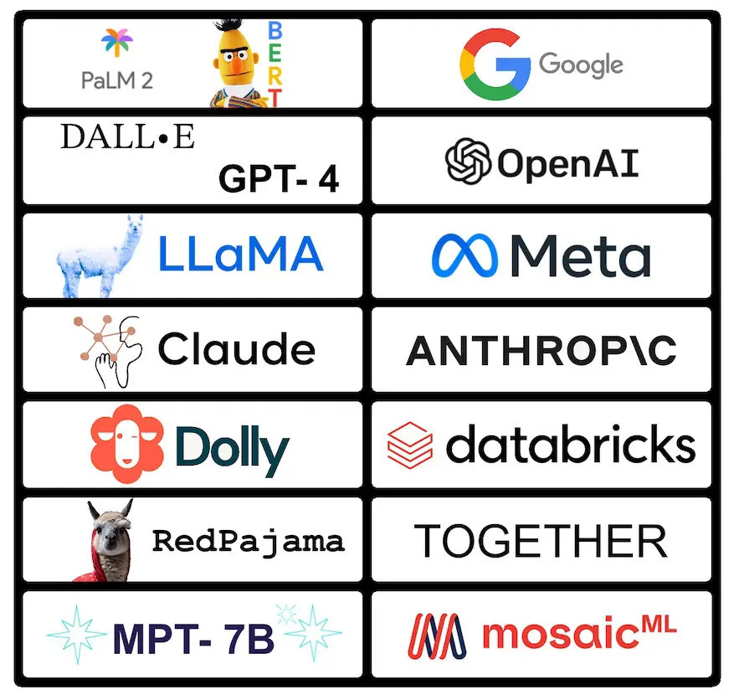
Generative AI Ecosystem
Foundation Model Providers
Companies that develop and offer large-scale AI models trained on vast datasets that serve as the foundation for various AI applications.
These models can generate text, images, code, and other content.
Examples
OpenAI (GPT-4)
Anthropic (Claude)
Google (Gemini)
Meta (Llama)
Mistral AI

Slide 25

Generative AI Ecosystem
Infrastructure Providers
Companies that supply the hardware, cloud computing resources, and specialized tools needed to train and deploy foundation models efficiently.
Examples
NVIDIA (GPUs)
AWS (cloud infrastructure)
Google Cloud (TPUs), Microsoft Azure
CoreWeave
Lambda Labs
Cerebras Systems

Slide 26
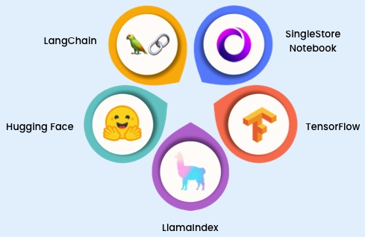
Generative AI Ecosystem
Frameworks
Software libraries and tools that simplify the process of building, fine-tuning, and deploying AI models, making advanced AI more accessible to developers.
Examples
Semantic Kernel
Langchain
Llamaindex
Haystack
Autogen

Slide 27
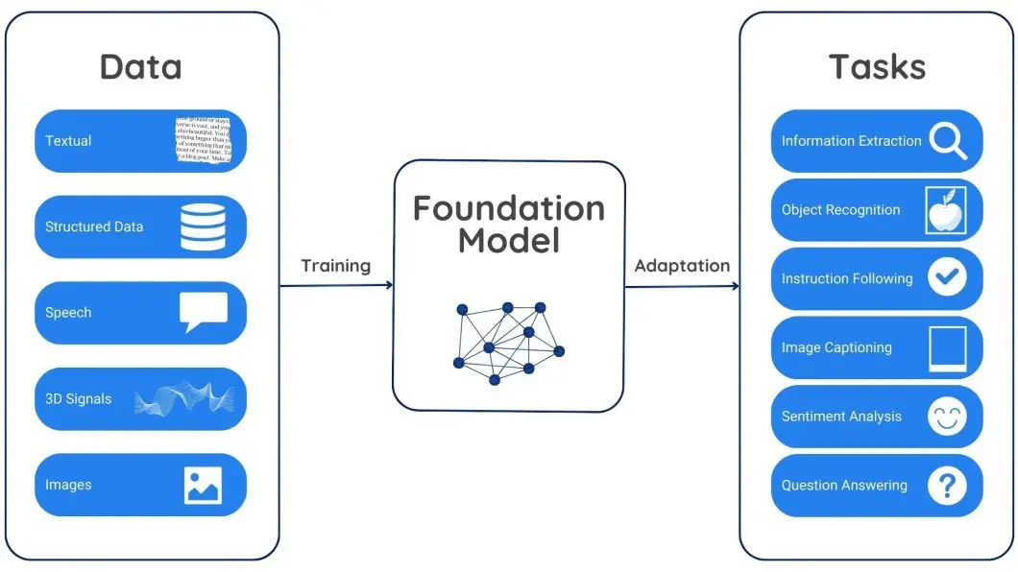
Generative AI Ecosystem
End-to-End Solution Providers
Companies that build complete AI applications or platforms by integrating foundation models with specific use cases, often including customization options and enterprise features.
Examples
Jasper.ai
Copy.ai
Midjourney
GitHub Copilot
Windsurf
Service Providers: Accenture, TCS, Wipro

Slide 28
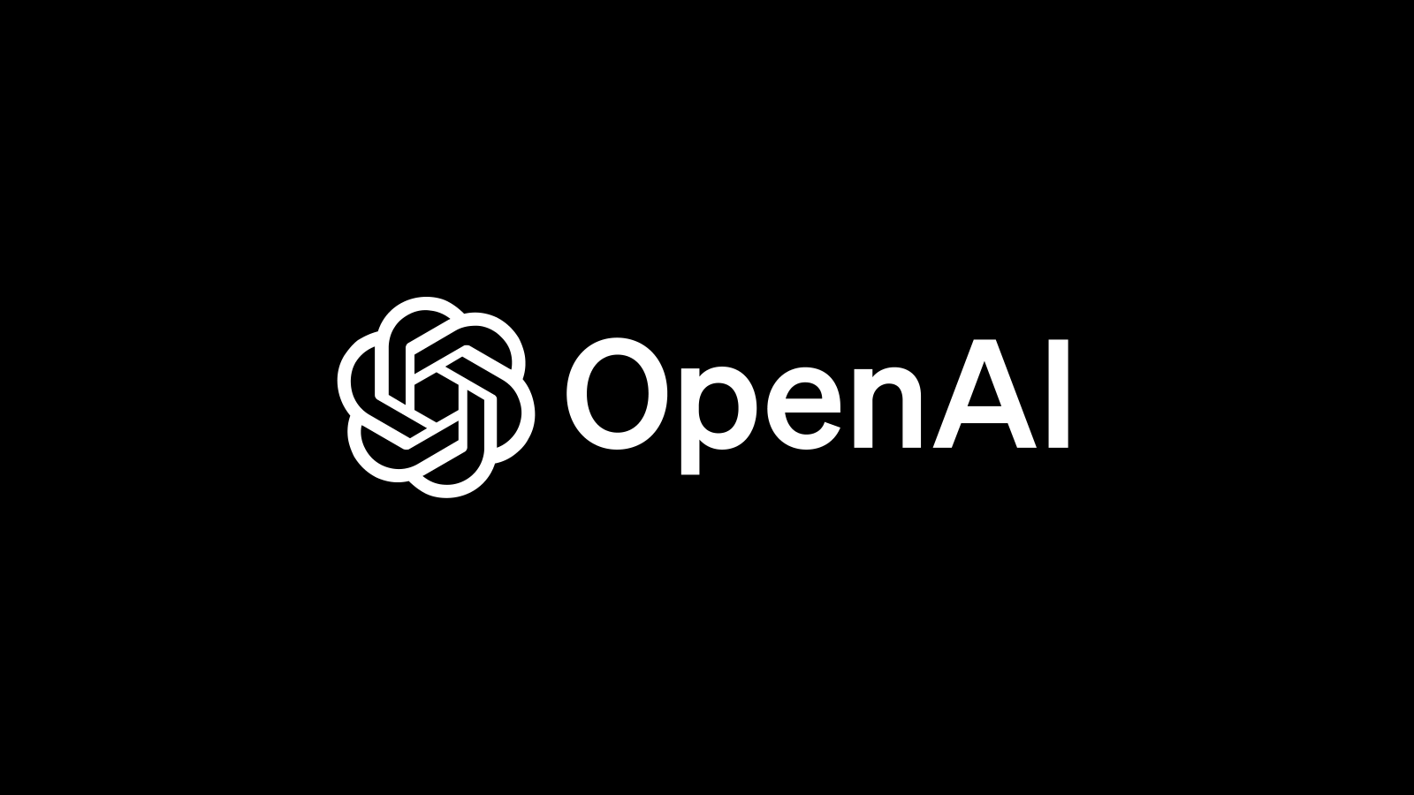


Key Organizations
Several key organizations have played crucial roles in initiating and advancing developments in Generative AI. Here are some notable organizations:
Developed the groundbreaking GPT series for natural language processing and DALL-E for image generation.
Advanced deep learning and neural networks, and developed TensorFlow, a major machine learning framework.
Pioneered AI-generated graphics and deep learning with GPUs and created the StyleGAN series.

Slide 29
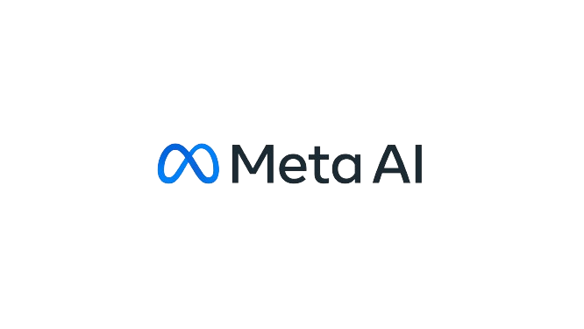


Key Organizations
Conducted extensive research in AI, including natural language and computer vision, and developed large-scale AI projects.
Created the Transformers library, a cornerstone in natural language processing.
Offers a set of frameworks in python and JS to develop, monitor and test advanced LLM applications.

Slide 30
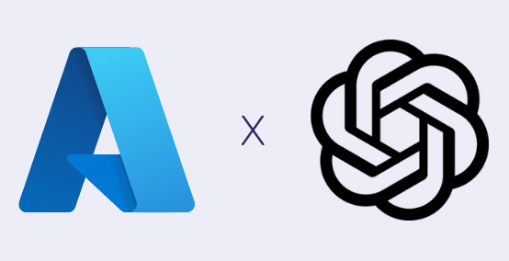
Generative AI Services
Azure OpenAI
Microsoft's cloud-based service that provides access to OpenAI's powerful models (including GPT-4, DALL-E, and others) through Azure's enterprise-grade infrastructure.
It offers enhanced security, compliance tools, and integration with Microsoft's broader ecosystem while allowing organizations to leverage OpenAI's models with the reliability and scalability of Azure.

Slide 31
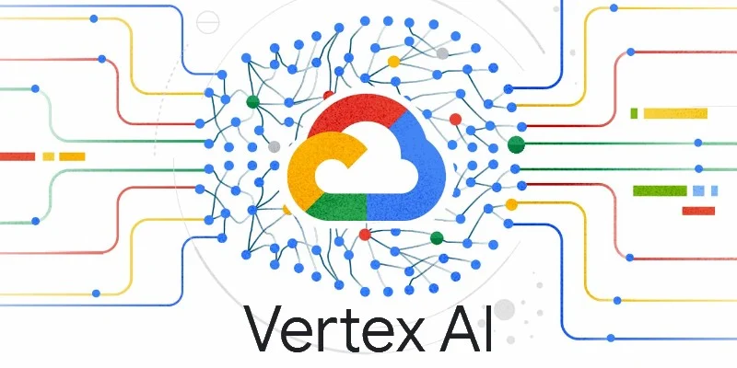
Generative AI Services
Vertex AI
Google Cloud's unified machine learning platform that includes generative AI capabilities.
It provides access to Google's foundation models (like Gemini) alongside tools for customizing models, building applications, and deploying AI at scale.
Vertex AI offers comprehensive MLOps features, data labeling services, and integrated development environments specifically designed for AI workloads.

Slide 32

Generative AI Services
Amazon Bedrock
AWS's fully managed service that makes foundation models from various AI companies (including Anthropic, AI21 Labs, Cohere, and Stability AI) available through a unified API.
Bedrock allows enterprises to experiment with different models, customize them with private data, and build generative AI applications while maintaining AWS's security, privacy, and compliance standards.
It integrates seamlessly with other AWS services for end-to-end AI solution development.

Slide 33
Real-World Use Cases Across Industries
BFSI (Banking, Financial Services, Insurance)
Use case: Customer-service copilot
An LLM reads historical case logs, policy documents, and product details.
Agents ask free-form questions: “What’s the best way to handle a premium holiday request for this profile?”
Benefits: faster handling time, more consistent responses, reduced training time for new agents.
Use case: Report and policy summarization
GenAI summarizes 150-page regulatory documents into 2-page briefs per department.
Teams save hours per month understanding new regulations and internal policies.
Retail
Use case: Product description generation
LLMs generate SEO-optimized descriptions in multiple languages from structured product data.
Marketing teams can launch new SKUs faster and maintain consistent tone across channels.
Use case: Personalized promotions
Given customer segments and purchase history, a model drafts personalized email and SMS campaigns.
Human marketers review/approve, but no longer write every message from scratch.
Healthcare
Use case: Clinical documentation assistant
During or after a consultation, the system drafts SOAP notes, discharge summaries, and patient instructions.
Doctors review and edit, which saves time and reduces burnout.
Use case: Knowledge lookup for clinicians
A chatbot on top of trusted medical guidelines answers natural-language queries with cited references.
Telecom
Use case: Network issue explainer
LLM reads incident reports, config files, and runbooks to generate simplified “what happened and why” explanations for non-technical stakeholders.
Use case: Self-care assistant
GenAI-powered chatbot resolves common issues (billing, data usage, plan changes) via omni-channel interfaces (web, app, WhatsApp, IVR transcripts).

Slide 34
Activity: Rapid Brainstorm – “Which parts of your job could GenAI automate?”
S. No. | Task / Activity (what you do weekly) | Why GenAI-friendly? (text-heavy / repetitive / retrieval) | Impact if automated (High / Medium / Low) | Risk / Sensitivity (High / Medium / Low) | Overall Priority (Quick win / Explore later / Avoid)
1
2
3
4
5
6

Slide 35
Activity: Rapid Brainstorm – “Which parts of your job could GenAI automate?”
S. No. | Task / Activity (Finance IT context) | Why GenAI-friendly? (text-heavy / repetitive / retrieval) | Impact if automated (High / Medium / Low) | Risk / Sensitivity (High / Medium / Low) | Overall Priority (Quick win / Explore later / Avoid)
1 | [Developer] Writing unit test stubs for new services | Highly repetitive, pattern-based code generation; text-heavy but formulaic | High (faster development, better coverage) | Medium (must ensure correctness, but low data sensitivity) | Quick win (with code review in place)
2 | [Developer] Translating legacy code comments (e.g., COBOL/Java) into modern English | Text translation and rewriting, low creativity, repetitive | Medium (improves maintainability and onboarding) | Low (internal technical context, minimal customer data) | Quick win
3 | [Developer] Summarizing application error logs after incidents | Information retrieval + summarization from verbose logs | High (faster root-cause analysis, reduced MTTR) | Medium (logs may contain IDs or partial PII) | Explore later (after masking/log-governance)
4 | [Architect] Drafting solution overview documents for new payment or lending platforms | Long, structured documents with standard sections and patterns | High (saves significant documentation time) | Medium (architecture, security and compliance details) | Explore later (use internal-secure GenAI)
5 | [Architect] Comparing two vendor proposals (e.g., core banking or AML tools) | Summarization, extraction of key points, side-by-side comparison | Medium (better decision support, faster evaluation) | Medium (commercial terms, legal language, pricing) | Explore later (with strict data handling)
6 | [Architect] Summarizing RFCs / internal technical standards | Dense, text-heavy documents; summarization and simplification | Medium (faster understanding for teams) | Low (internal standards, usually non-customer-specific) | Quick win
8 | [BU Head / Leader] Compiling meeting notes from steering committees / governance calls | Summarization of call transcripts or notes; highly repetitive | Medium (better documentation, less manual effort) | Medium (strategy, roadmap, partner info) | Quick win (using compliant internal tools)
9 | [BU Head / Leader] Writing follow-up emails after client or regulator meetings | Text-heavy, repetitive phrasing, similar structures | Medium (saves time, improves clarity and tone) | Medium (external communication but not deeply sensitive if reviewed) | Quick win (with human review before sending)

Slide 36
Working with LLMs

Slide 37




Large Language Model
Understanding Large Language Model
A Large Language Model (LLM) is a computer program that understands and writes human language.
It learns by reading lots of text and can answer questions, write stories, or help with many language tasks.

Slide 38
Key Terminologies
Tokens
A token is a small unit of text—often a word or sub-word piece. For English, 1 token ≈ 3–4 characters on average.
Embeddings
Once the text is tokenized, each token is converted into a vector—a list of numbers. This is called an embedding. Embeddings capture semantic meaning: similar words have similar vectors.

Slide 39
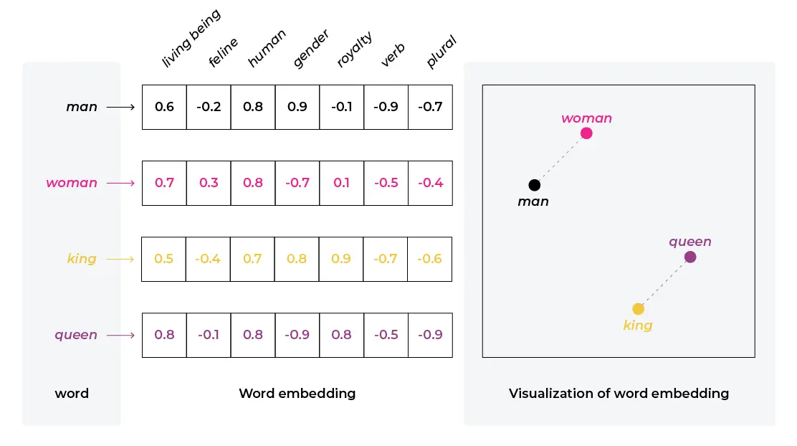
Text Embeddings
A semantic relationship refers to the way words or phrases relate to each other in terms of meaning.
Example: Word2Vec is a popular model for generating word embeddings. If you take words like "king" and "man" and perform vector arithmetic by subtracting "man" from "king" and then adding "woman," you often get a result close to the vector for "queen."

Slide 40




Transformers

Slide 41
Language Model Pipeline: Text Generation
Language Models: Next Word prediction engine
Input: Hi, How
Step1 : Input -> Hi, How, output-> are
Step 2: input-> Hi, How, are output -> you
Step 3: input-> Hi, How, are, you output-> ?

Slide 42
Language Model Pipeline
Input
Tokenize
Encode
Generate
Repeat
Decode
User prompt in natural language.
Split into tokens.
Convert tokens to embeddings and process them through layers of the transformer network.
At each step, the model predicts a probability distribution over the next token and samples / selects one.
The new token is appended, and the model repeats the process, building the output sequence token by token.
Convert tokens back to human-readable text.

Slide 43
LLM Selection
Context Windows
The context window is the maximum number of tokens the model can consider at once (prompt & output). Typical ranges today: 32K tokens (roughly 50–70 pages of text) for many models. 128K, 200K, or even 1M tokens for some advanced models like Claude Sonnet and certain OpenAI models. If you need to work with large documents or codebases, longer context windows are important. Example: 1M-token context can handle entire code repositories or large contract bundles; 32K-token context might require chunking strategies.
Model Size
Model names often hint at size (number of parameters): e.g., GPT-4 / GPT-5, Llama 3 (8B, 70B), Mixtral (8×7B MoE), Phi-3, etc. Larger models: Better reasoning, generalization, and robustness. More expensive per call. Smaller models: Lightweight, cheaper, can run on-prem or on edge devices.
Modality
Text-only vs. text+image vs. fully multimodal (text, image, audio, video). For: Image generation: diffusion models (DALL·E, Stable Diffusion). Image understanding: multimodal LLMs (GPT-4o, Gemini, Claude)

Slide 44
How to select LLMs?
Size: params
Type of model: foundation model / Instruct version
Number of Input tokens, output tokens
Dataset used to train LLMs
Operational Metrices: response time, output format supported
Usage Approach: Function Calling Supported
Modalities: Input Modalities supported
Function Metrics: Perplexity, BLEU, ROUGE Scores
Content Specific Metrics: Toxicity, Conciseness(exact Match), ARI Grade Level, Kincaid Score

Slide 45
LLMs by Vendors
Vendor | Notable Models & Services | Strengths & Use Cases
OpenAI | GPT‑4/GPT‑4 Turbo, DALL·E 3, Whisper | Market leader in performance and multimodality
Anthropic | Claude series (Claude 3 Opus, etc.) | Focus on safety, reasoning, and enterprise use — integrated via AWS Bedrock
Cohere | Command models | Enterprise integration, multi‑tenant deployment options
Google | Gemini series | Strong multimodal performance and tooling in Vertex AI
Amazon | Titan, Olympus; Anthropic via Bedrock | Multi-model API flexibility in AWS ecosystem
Microsoft | Azure OpenAI (GPT‑4); Llama 2 via Azure AI; prompt-flow, AI Foundry | Enterprise-grade security, integration with MS365 and Bing; responsible AI tooling
Meta | Code Llama, Llama 2/3 API; instruction‑tuned models | Free for commercial use; open licensing; flexible deployment
X.com (xAI) | Grok 4/4 Heavy via X app & API; Grok‑1 open‑source LLM | Real-time social integration on X; multimodal image + reasoning; transparency via GitHub; premium tiers

Slide 46
Large Language Model
Key Concepts
Concept | Definition | Key Characteristics
Multimodal LLMs | AI models that process and generate multiple types of media including text, images, audio, and video. | Integrate diverse information types. Enable cross-modal understanding. Support complex applications like visual Q&A. Create more natural human-AI interaction.
Embeddings | Mathematical vector representations of data in high-dimensional space that capture semantic relationships. | Preserve contextual meaning. Enable similarity comparisons. Support clustering and classification. Form the foundation for retrieval systems.
Prompt Engineering | The practice of designing optimal inputs to guide AI models toward generating desired outputs. | Requires understanding of model behavior. Incorporates techniques like few-shot learning. Balances specificity with flexibility. Evolves with model capabilities.
Tokens | The basic processing units of language models that represent words, parts of words, or symbols. | Determine context window size. Impact computational requirements. Affect model pricing and usage limits. Influence output coherence and quality.

Slide 47
Generative AI Service Providers
 | Azure OpenAI | Vertex AI (Google) | Amazon Bedrock
Main Provider | Microsoft Azure | Google Cloud | Amazon Web Services (AWS)
Model Support | OpenAI (GPT-4, GPT-3.5, DALL·E, etc.) | PaLM, Gemini, Codey, Imagen | Claude (Anthropic), AI21, Cohere, Meta, Mistral
Best For | Text generation, enterprise integration | Full ML pipeline, custom model building | Multi-model choice, fast deployment
Integration | Strong with Microsoft tools (Office, Teams) | Strong with Google tools (Gmail, Docs, Sheets) | Strong with AWS services (S3, Lambda, SageMaker)
Customization | Limited fine-tuning, embeddings available | Supports fine-tuning, AutoML, pipelines | Agents, Guardrails, and some customization tools
Security & Compliance | Enterprise-ready, HIPAA, ISO, SOC | Strong security, private service options | High compliance for finance, healthcare, etc.
UI & Tools | Azure Portal, OpenAI Studio | Google Console, Notebooks, Vertex Pipelines | Bedrock Console, API-first design

Slide 48
Generative AI Application Architectural Patterns

Slide 49
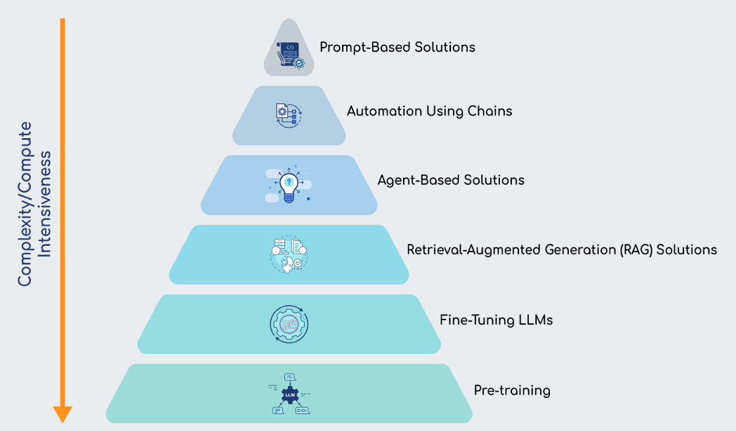

Enterprise Generative AI Architecture

Slide 50
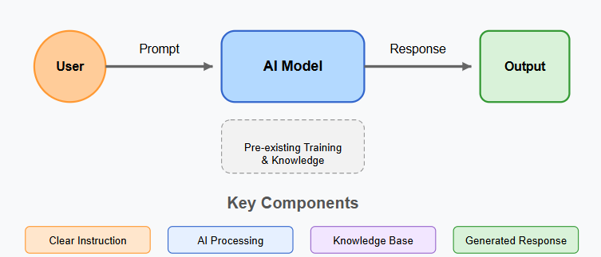
Generative AI Application
Prompt-Based Solutions
Prompt-based solutions involve providing an AI model with a clear, specific instruction or question, typically in the form of text.
The model generates a response based on the prompt using its pre-existing training and knowledge.
This method is a simple interaction where the AI responds directly to a user's input without any need for additional data or context.
The success of the response heavily depends on the clarity and specificity of the prompt.

Slide 51

Generative AI Application
Examples of Applications: Prompt-Based Solutions
Customer Support Chatbots
Content Creation Tools
Interactive Educational Tools
Code Assistance
Translation Services
Notes:
Examples of Applications
Customer Support Chatbots: A user asks a question, and the prompt-based solution generates a relevant response from a large knowledge base.
Content Creation Tools: AI-powered tools like article generators where the user provides a topic, and the system generates a blog post or article.
Interactive Educational Tools: AI tutors that answer student questions or generate explanations on various topics based on the prompt.
Code Assistance: Tools like GitHub Copilot that generate code suggestions based on the user's input prompt (e.g., "Create a Python function for sorting an array").
Translation Services: AI-powered translation where the user inputs text in one language, and the system translates it to another based on prompts.

Slide 52
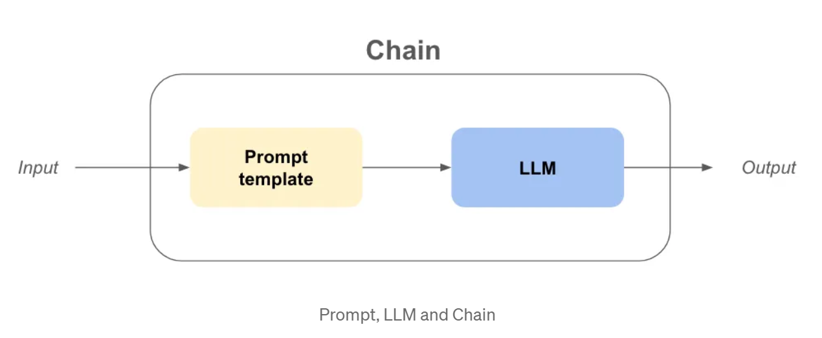
Generative AI Application
Automation Using Chains
Automation using chains refers to linking multiple tasks or prompts together in a sequence to automate a complex process.
Each output from one task becomes the input for the next step in the chain, creating a workflow that automates multi-step processes.
It allows for the automation of intricate tasks where multiple operations are required.
For instance, the AI might first analyze text, then generate a summary, and refine it based on feedback, each step building upon the previous.

Slide 53
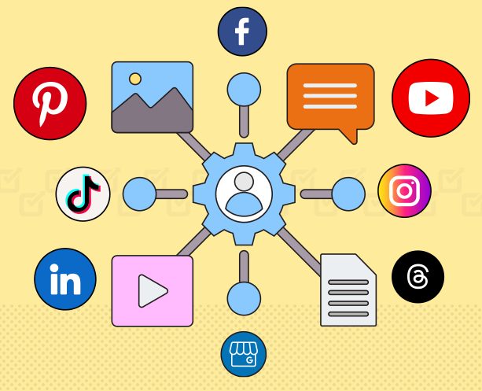
Generative AI Application
Use cases: Automation Using Chains
Document Review Automation
E-commerce Order Processing
Customer Feedback Analysis
Social Media Content Management
Financial Reporting Automation
Notes:
Document Review Automation: Automate the process of reviewing legal contracts or agreements, where AI first extracts key clauses, then evaluates them for potential issues, and finally produces a report.
E-commerce Order Processing: A chain of tasks like verifying stock, processing payment, generating an invoice, and confirming the order to the customer.
Customer Feedback Analysis: Chaining tasks where customer feedback is first categorized, analyzed for sentiment, then summarized, and finally used to generate a response or improve products.
Social Media Content Management: Automating content creation, posting, and performance analysis, where the chain starts with generating posts, followed by scheduling, then tracking engagement.
Financial Reporting Automation: AI can pull data from various sources, perform calculations, generate visualizations, and finally compile a report ready for review.

Slide 54
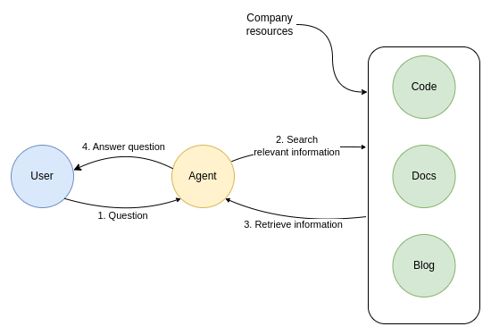
Generative AI Application
Agent-Based Solutions
Agent-based solutions involve creating an autonomous AI agent that can perform tasks, make decisions, and adapt to changing conditions with minimal human input.
These agents operate independently once initialized and can take actions to meet a goal over time.
The AI agent works autonomously, making decisions and acting toward achieving a larger objective without needing direct input at each step.
These systems are designed to adapt to various situations and manage long-term tasks, such as scheduling or project management.

Slide 55


Agentic AI
Agentic AI refers to artificial intelligence systems that act as autonomous agents — capable of setting goals, making decisions, and taking actions proactively, often in complex environments, without needing constant human input.
Notes:
“Think of a support agent who can check your bill, flag an issue, raise a ticket, suggest a better plan, and remember what you asked last month. That’s Agentic AI — a full-on digital co-worker.”

Slide 56
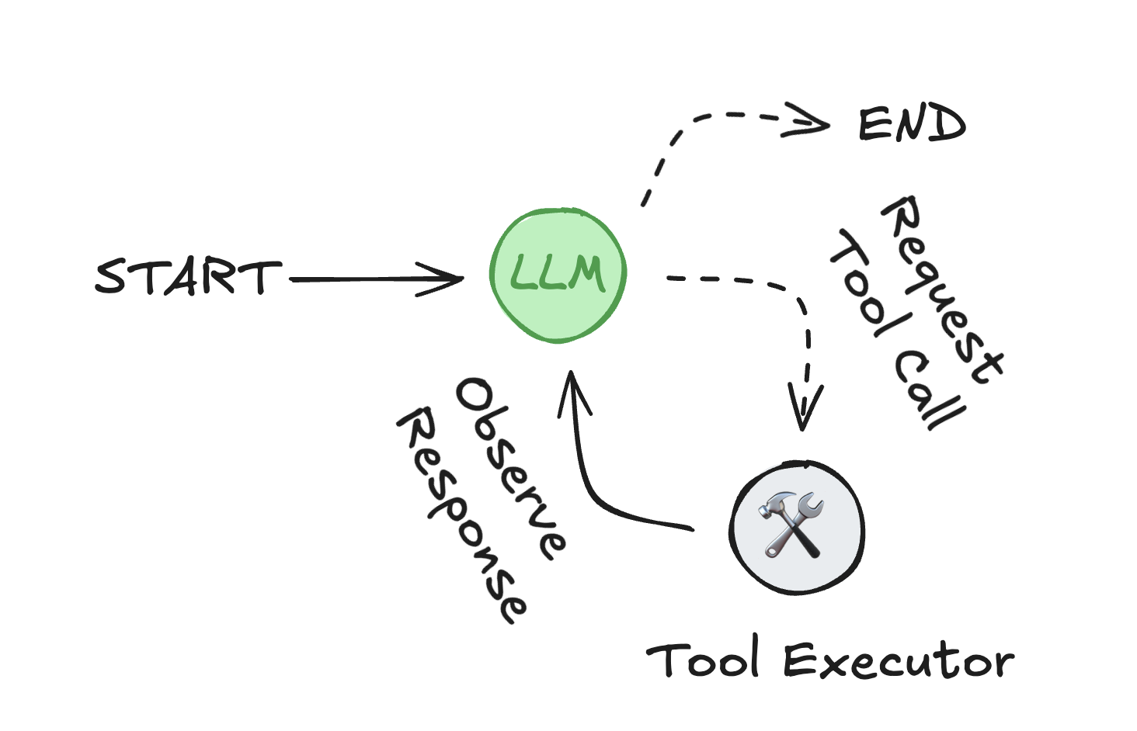
Agentic AI
An agent consists of three components: a large language model (LLM), a set of tools it can use, and a prompt that provides instructions.
https://react-lm.github.io/

Slide 57

Generative AI Application
Use cases: Agent-Based Solutions
AI-Powered Virtual Assistants
Autonomous Vehicles
Automated Content Moderation
Financial Advisors
Supply Chain Optimization
Notes:
AI-Powered Virtual Assistants: An agent that not only answers queries but also schedules meetings, sends reminders, and organizes emails.
Autonomous Vehicles: An AI agent that controls a self-driving car, making real-time decisions based on traffic, road conditions, and passenger needs.
Automated Content Moderation: AI agents that monitor user-generated content for inappropriate or harmful material across platforms like social media or forums.
Financial Advisors: An AI agent that autonomously monitors a user's investments, recommends strategies, and adapts to changes in the market.
Supply Chain Optimization: An AI agent that manages logistics, inventory, and resource allocation, adjusting operations in real-time based on demand and supply conditions.

Slide 58
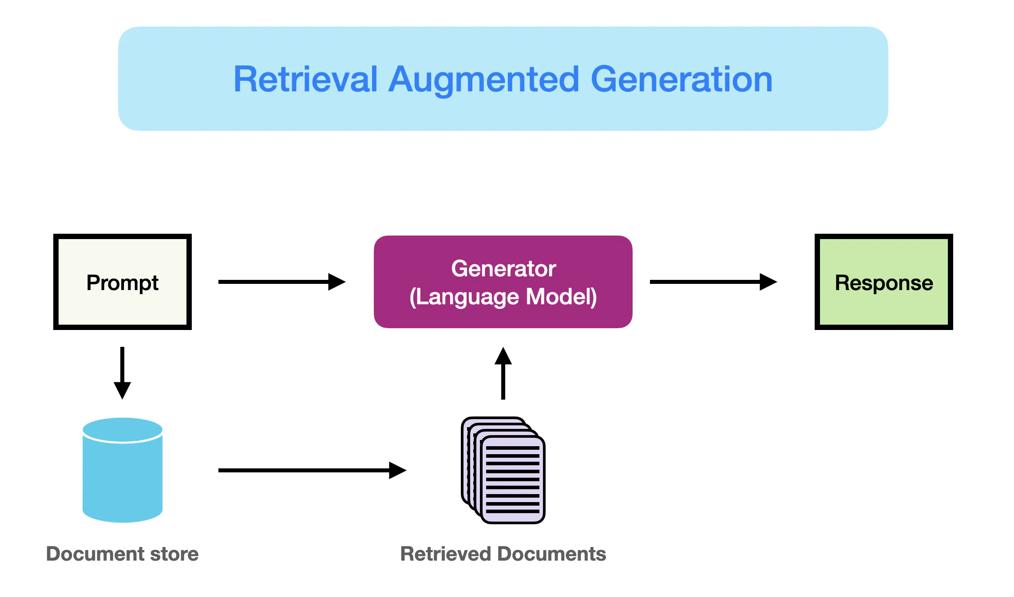
Generative AI Application
Retrieval-Augmented Generation (RAG) Solutions
RAG solutions enhance the AI's ability to generate responses by retrieving relevant data from external sources, like databases or documents, before generating a response.
This helps the model answer questions more accurately.
By integrating information retrieval with language generation, RAG systems ensure that responses are grounded in real-time or domain-specific data.
This is particularly useful for tasks requiring precise, factual, or current information.

Slide 59
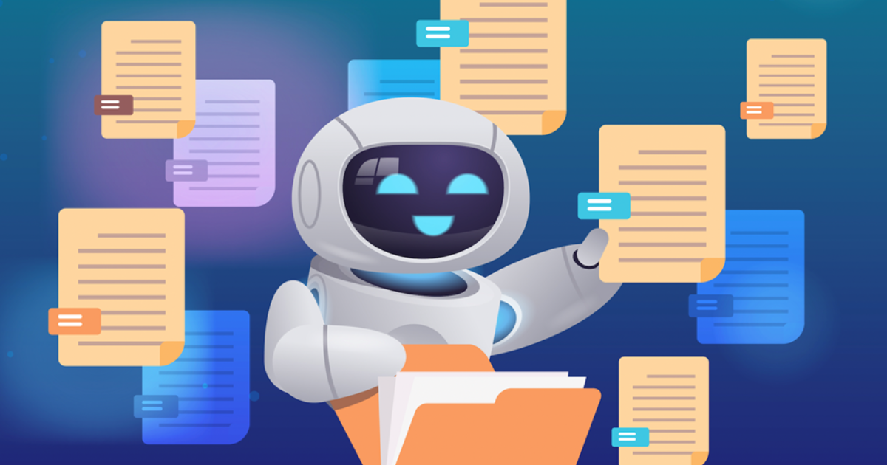
Generative AI Application
Use cases: Retrieval-Augmented Generation (RAG)
Customer Support with Knowledge Base
Research Paper Generation
Legal Document Review
Personalized Learning Systems
Technical Documentation Assistance
Notes:
Customer Support with Knowledge Base: RAG systems retrieve data from a company's knowledge base to provide accurate, context-aware responses to customer queries.
Research Paper Generation: AI can retrieve relevant research papers and summarize them or combine insights to generate new research proposals or reports.
Legal Document Review: In legal applications, RAG can pull from a case law database and generate summaries or insights based on specific legal queries.
Personalized Learning Systems: AI can retrieve educational resources tailored to the student’s query and generate personalized learning materials.
Technical Documentation Assistance: For industries like software development or engineering, RAG can retrieve technical manuals and generate answers to highly specific technical queries.

Slide 60
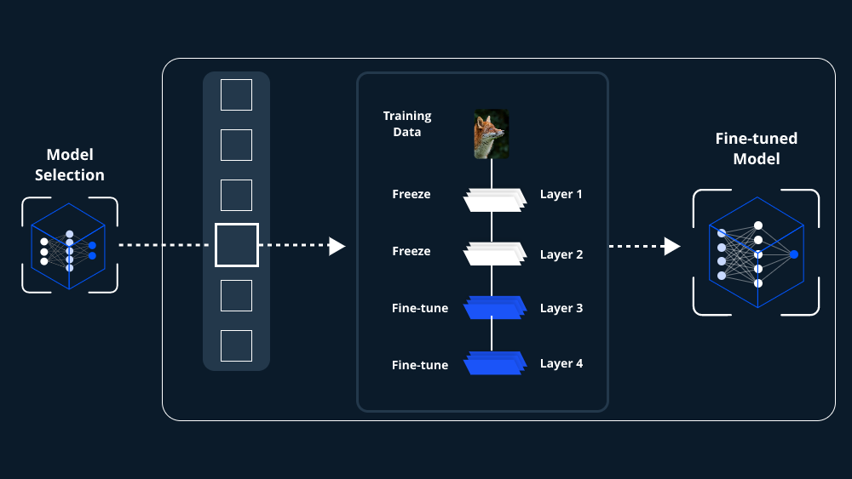
Generative AI Application
Fine-Tuning LLMs
Fine-tuning involves taking a pre-trained large language model (LLM) and further training it on a specialized dataset related to a specific task or domain.
This customization improves the model's performance for particular applications, such as legal or medical tasks.
Fine-tuning adapts a general-purpose language model to a specific field, improving its understanding and ability to handle domain-specific language, terminology, and requirements by training on smaller, targeted datasets.

Slide 61

Generative AI Application
Use cases: Fine-Tuning LLMs
Custom Chatbots for Specific Industries
Automated Content Generation for Niche Blogs
Sentiment Analysis for Customer Feedback
Task-Specific Document Drafting
Customer Service Automation
Notes:
Custom Chatbots for Specific Industries: Fine-tuning allows chatbots to be tailored to specific industries, such as banking or healthcare, where they understand jargon and domain-specific nuances.
Automated Content Generation for Niche Blogs: Fine-tuning an AI model on a specific type of content (e.g., travel blogs) so it can generate articles that match the tone, structure, and content style of that domain.
Sentiment Analysis for Customer Feedback: Fine-tuning a model to detect customer sentiment from feedback, reviews, or social media comments for better market analysis.
Task-Specific Document Drafting: Fine-tuning on legal, medical, or financial documents enables the model to draft documents, such as contracts, diagnoses, or reports, more effectively.
Customer Service Automation: Fine-tuning an LLM for specific customer service scenarios, enabling it to handle customer complaints, order status inquiries, or service troubleshooting in a given domain.

Slide 62
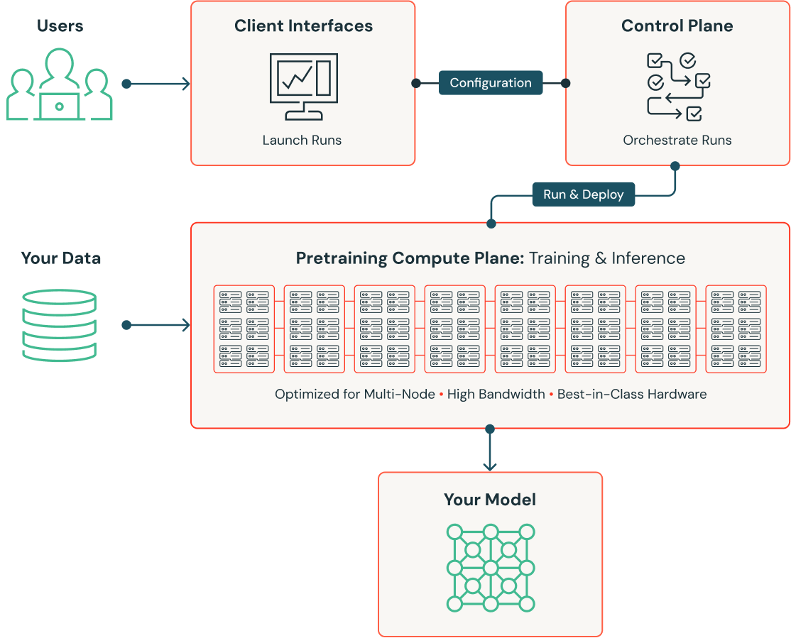
Generative AI Application
Pre-Training
Pre-training is the initial phase of training a large language model where it learns fundamental language patterns and structures by processing a vast amount of text data.
This phase is unsupervised and helps the model understand the basics of language.
During pre-training, the model learns general language concepts, such as grammar, syntax, and semantic patterns, which serve as the foundation for later, more specialized training (fine-tuning).
Pre-training provides the basic knowledge the model needs to generate and understand human-like text.

Slide 63

Generative AI Application
Use cases: Pre-Training
General Text Generation
Foundation for Specialized Models
Natural Language Understanding for Voice Assistants
Search Engine Ranking Algorithms
Building Conversational Agents
Notes:
General Text Generation: Pre-trained models can generate text for various purposes, including creative writing, reports, or blogs.
Foundation for Specialized Models: Pre-trained models serve as the base for fine-tuning into more specialized systems like medical or legal document generation.
Natural Language Understanding for Voice Assistants: Pre-training models on large text corpora enables them to understand and respond to voice commands in virtual assistants.
Search Engine Ranking Algorithms: Pre-training on vast amounts of text data can help build better search ranking algorithms, understanding the context of user queries.
Building Conversational Agents: Pre-training is key for building chatbots or virtual assistants that understand human language in a wide array of contexts, from casual conversations to technical support.

Slide 64
Task
Userinput: Domain (e.g. Finance / Telecom / Healthcare)
LLM output: a table to map use cases in the domain for 1. Prompt based solutions, 2. static workflows with LLMs, 3. Agentic Workflows, 4. RAG workflows
For each category 2 use cases.

Slide 65

The art of the prompt
Goal
What do you want from Copilot?
Context
Why do you need it and who is involved?
What information or samples do you want Copilot to use?
Source(s)
Expectations
How should Copilot respond to best fulfill your request?
Notes:
Trainer Notes:
An effective prompt can significantly enhance Copilot's output, ensuring accurate and contextually appropriate responses. Prompts can include four parts: the goal, context, expectations, and source, as described in the following image
When you ask someone for something at work, you should provide context and resources. The same goes for working with Copilot. When you ask it to do something for you, the quality of what you get back is a function of how you make the request. And knowing how to prompt is the key to unlocking the power and potential of generative AI. To get the best response, it’s important to know how to frame and phrase your Copilot prompts.
It is a good idea to discuss that all you need is a “goal” for a prompt, but that would considered a “bad” prompt.
You can interact with the group by saying something like “When I say “Red” you think?” wait for a response.. “When I say “red emergency vehicle” you think?” – this shows the progression of a prompt.
https://learn.microsoft.com/training/modules/executives-guide-to-crafting-prompts/2-explore-the-art-of-the-prompt

Slide 66
Research a topic using Microsoft 365 Copilot Chat
Goal
Context
Source(s)
Expectations
What do you want
from Copilot?
Why do you need it
and who is involved?
What information or samples do you want Copilot to use?
How should Copilot respond to best fulfill
your request?
+
+
+
“I want to understand the benefits of hybrid work models...”
“...as our company considers adopting a hybrid work environment.”
“Using academic articles, industry reports, and case studies from other companies…”
“…provide a summary of key findings, including statistics and examples."
=
Final Prompt
I want to understand the benefits of hybrid work models as our company considers adopting a hybrid work environment. Using academic articles, industry reports, and case studies from other companies, provide a summary of key findings, including statistics and examples.
Notes:
Trainer Notes:
Important: This slide includes 'start on click' animations. The prompts under goal, context, sources, expectations, and the final prompt will not appear until you click. This feature enables you to discuss each aspect of the prompt structure individually.
This slide is an example of a prompt someone may use to research a topic.
Deepen the "context" piece of the prompt by adding more detail. Pause to highlight that this is where you would add the specific things you are concerned about with hybrid work such as environment savings, theme impact, what is it like for your particular industry? For example: "What are the cost benefits of adopting a hybrid work environment?" or "What are the employee morale benefits of adopting a hybrid work environment?"

Slide 67

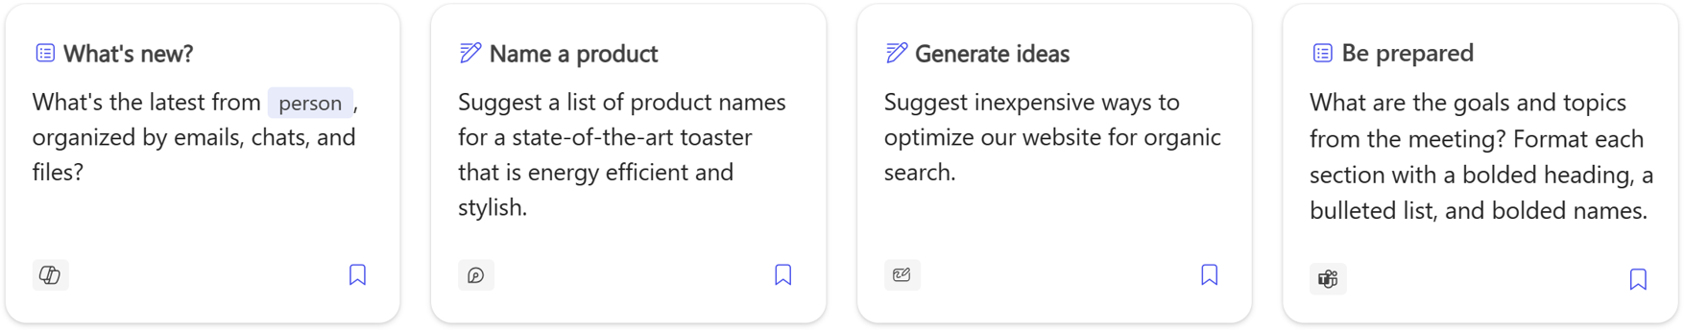
Copilot Prompt Gallery
Start your Copilot Journey
Powerful prompts, a click away
aka.ms/CopilotGallery
Notes:
Trainer Notes:
The Copilot Prompt Gallery helps users get started with the art of prompting and helps organizations with onboarding and adoption by providing a single experience that meets Copilot users where they are in their journey. The Copilot Prompt Gallery isn’t just prompts, it’s a library of comprehensive learning resource that helps everyone begin their Copilot journey with confidence and take advantage of Copilot in their daily work.
It consolidates our best resources - including training videos, ready-made prompts, and inspiration drawn from our internal best practices, insights from early adopters, findings from the Microsoft Research team, and thought leadership. This consolidation makes Copilot Lab your comprehensive guide to starting with generative AI.
The Copilot Prompt Gallery shows up in Microsoft 365 Copilot, Word, PowerPoint, Excel, and OneNote via the small notebook icon that suggests relevant prompts to inspire you.
https://learn.microsoft.com/training/modules/executives-guide-to-crafting-prompts/3-explore-copilot-lab

Slide 68
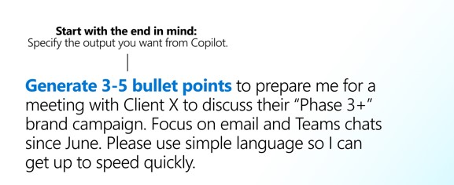
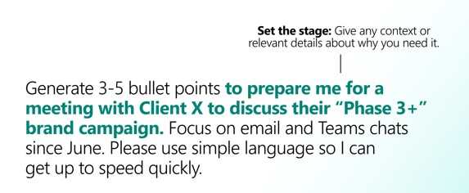
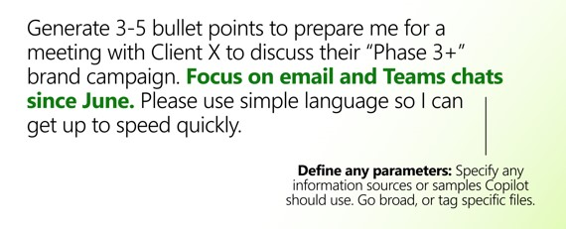
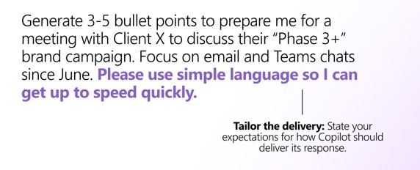
Examine how to build an effective prompt (continued)
The following steps highlight the most important things to consider when building an effective prompt:
1
2
3
4

Slide 69
Review prompting best practices
Craft clear and specific prompts for optimal Copilot performance. Here are some best practices:
Provide clear and concise prompts
Make your request unambiguous
Keep it brief without sacrificing clarity
Use positive instructions and "if-then" statements
Give examples for desired output, leveraging AI's imitation capability
Experiment with different styles
Get creative with tone, language, and styles
Explore analogies, poems, or historical allegories for diverse results
Give Copilot a point of view from which to answer
Give Copilot a context by providing a point of view
Roleplay scenarios or ask for responses in a specific style or persona
Know what to avoid when creating a prompt
Avoid vague or overly general prompts
Don’t cram too many questions into one prompt
Don't assume Copilot has the context

Slide 70
Review prompting best practices (continued)
Craft clear and specific prompts for optimal Copilot performance. Here are some best practices:
Understand Copilot's limitations
Break down complex tasks for better results
Optimize for repetition in simple, repetitive tasks
Be aware of potential misinterpretation of ambiguous prompts
Aim for clarity
Review and validate Copilot’s responses
Be polite
Follow basic etiquette to generate respectful, collaborative outputs
Practice politeness to enhance AI responsiveness and performance
Start prompts with "please" and express gratitude
Be curious
Ask preliminary questions
Use curiosity to better understand problems and provide specific instructions
Iterate, iterate, iterate
Don't give up after one prompt; it's a dynamic process
Provide feedback for improvement
Experiment, iterate, and refine prompts until you’re satisfied

Slide 71
Day 2

Slide 72
Generative AI Application
Prompt-Based Solutions
Prompt-based solutions involve providing an AI model with a clear, specific instruction or question, typically in the form of text.
The model generates a response based on the prompt using its pre-existing training and knowledge.
This method is a simple interaction where the AI responds directly to a user's input without any need for additional data or context.
The success of the response heavily depends on the clarity and specificity of the prompt.

Slide 73
Generative AI Application
High-level Architecture Of Prompt-based Solutions
Application UI / API Call
Input Data
Prompt Template
LLM (Large Language Model)
JSON Response
Application UI / API Response
Notes:
High-Level Architecture
Application UI / API Call The user interacts with the system through the UI (for web, mobile, etc.) or sends an API request. This triggers the process for generating a response based on the input prompt.
Input Data The user provides input data, which can be in the form of a question, command, or instruction. This data is essential for forming the prompt that will guide the AI in generating a response.
Prompt Template A prompt template is applied to structure the input data. The template can be pre-defined or dynamically generated, depending on the context of the application. This structure helps shape the interaction with the Large Language Model (LLM) for more accurate results.
LLM (Large Language Model) The structured prompt is sent to the LLM (such as GPT-3, GPT-4, or a domain-specific model). The model processes the prompt using its training to generate a response based on the input.
JSON Response The LLM generates a response, which is typically in JSON format containing the output text and any relevant metadata (e.g., confidence score, processing time).
Application UI / API Response The JSON response is sent back to the application UI or API, where it is parsed and formatted as required. The user then receives the generated output, such as an answer to their question or a piece of content based on their prompt.

Slide 74
Generative AI Application
Examples of Applications: Prompt-Based Solutions
Customer Support Chatbots
Content Creation Tools
Interactive Educational Tools
Code Assistance
Translation Services
Notes:
Examples of Applications
Customer Support Chatbots: A user asks a question, and the prompt-based solution generates a relevant response from a large knowledge base.
Content Creation Tools: AI-powered tools like article generators where the user provides a topic, and the system generates a blog post or article.
Interactive Educational Tools: AI tutors that answer student questions or generate explanations on various topics based on the prompt.
Code Assistance: Tools like GitHub Copilot that generate code suggestions based on the user's input prompt (e.g., "Create a Python function for sorting an array").
Translation Services: AI-powered translation where the user inputs text in one language, and the system translates it to another based on prompts.

Slide 75
Generative AI Application
Example Architecture With Azure Of Prompt-based Solutions
Create a New Azure OpenAI Resource
Deploy API in container
Create an Azure Account
Retrieve Keys and Endpoints
Create a New Resource Group
Deploy LLM
Create an API
Test and Use the Deployed API
Notes:
1. Create an Azure Account
Ensure you have an Azure account.
Apply for access to Azure OpenAI if it's not yet available in your account (it requires approval from Microsoft).
2. Create a New Resource Group
A resource group helps you organize and manage resources in Azure.
In the Azure portal, create a new resource group (you can create one with a name relevant to your project).
3. Create a New Azure OpenAI Resource
After the resource group, create an Azure OpenAI resource. This will allow you to use Azure's OpenAI models.
Choose the right region, and you may have to select the right tier based on your needs.
4. Deploy the Model
After the OpenAI resource is set up, you can choose which models to use (e.g., GPT-3, Codex, etc.).
You can either use pre-trained models or fine-tune them based on your requirements.
5. Retrieve Keys and Endpoints
Once your Azure OpenAI resource is created, you'll need to access the keys and endpoints.
These will allow your application to authenticate and interact with the OpenAI models.
6. Create an API
Set up an API to interact with your OpenAI models. This can be done using Azure Functions, App Services, or any other suitable backend technology.
You'll use the keys and endpoints to authenticate API calls to OpenAI.
7. Deploy API in Container
If you want your API to be easily scalable and portable, deploying it in a container (e.g., Docker) can be an excellent option.
You can deploy your containerized API on Azure Kubernetes Service (AKS) or Azure App Services.
Azure also supports container registries where you can push your containers.
8. Test and Use the Deployed API
Test the API: Once the API is deployed, the first step is to test it.
Ensure the API correctly integrates with the OpenAI model and returns the expected results (e.g., prompt-based responses).
Validate that authentication is working (ensure API keys or OAuth tokens are being correctly passed).
Integrate with Frontend or Other Systems:
If your solution has a frontend (like a web or mobile app), integrate the API into the frontend.
Send requests to the API, pass user inputs (prompts), and display the model's responses to users.
You can also integrate the API with other backend systems or applications that require AI-driven responses.

Slide 76
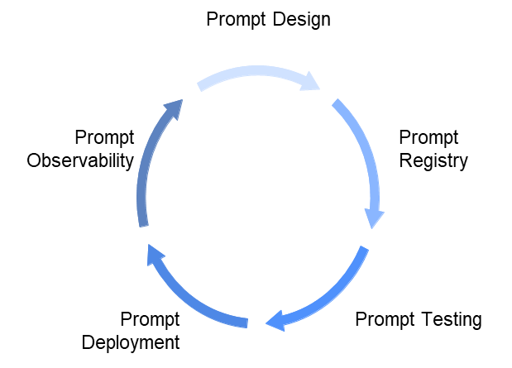
PromptOps
1. Prompt Design
Template Structuring:
Use variables ({product_name}, {sensor_data}) in prompt bodies.
Structure for zero-shot, few-shot, or chain-of-thought scenarios.
Prompt Types:
Instructional (“Summarize this document…”)
Conversational (“You are a safety compliance expert…”)
Functional (code completion, decision support)

Slide 77
PromptOps
1. Prompt Design
Scenario: Fault Detection & Root Cause Analysis in Smart Factories
Context: An enterprise provides digital twin solutions and energy optimization for factories. Their AI assistant integrates with machine telemetry, maintenance logs, and ERP systems to assist plant operators.
prompt = """
You are a manufacturing safety advisor. Analyze the following sensor data and maintenance logs to determine the most likely cause of equipment failure.
Sensor Data:{sensor_data}
Maintenance Logs:{maintenance_notes}
Respond with:
- Fault Classification
- Suggested Fix
- Safety Implications
"""

Slide 78
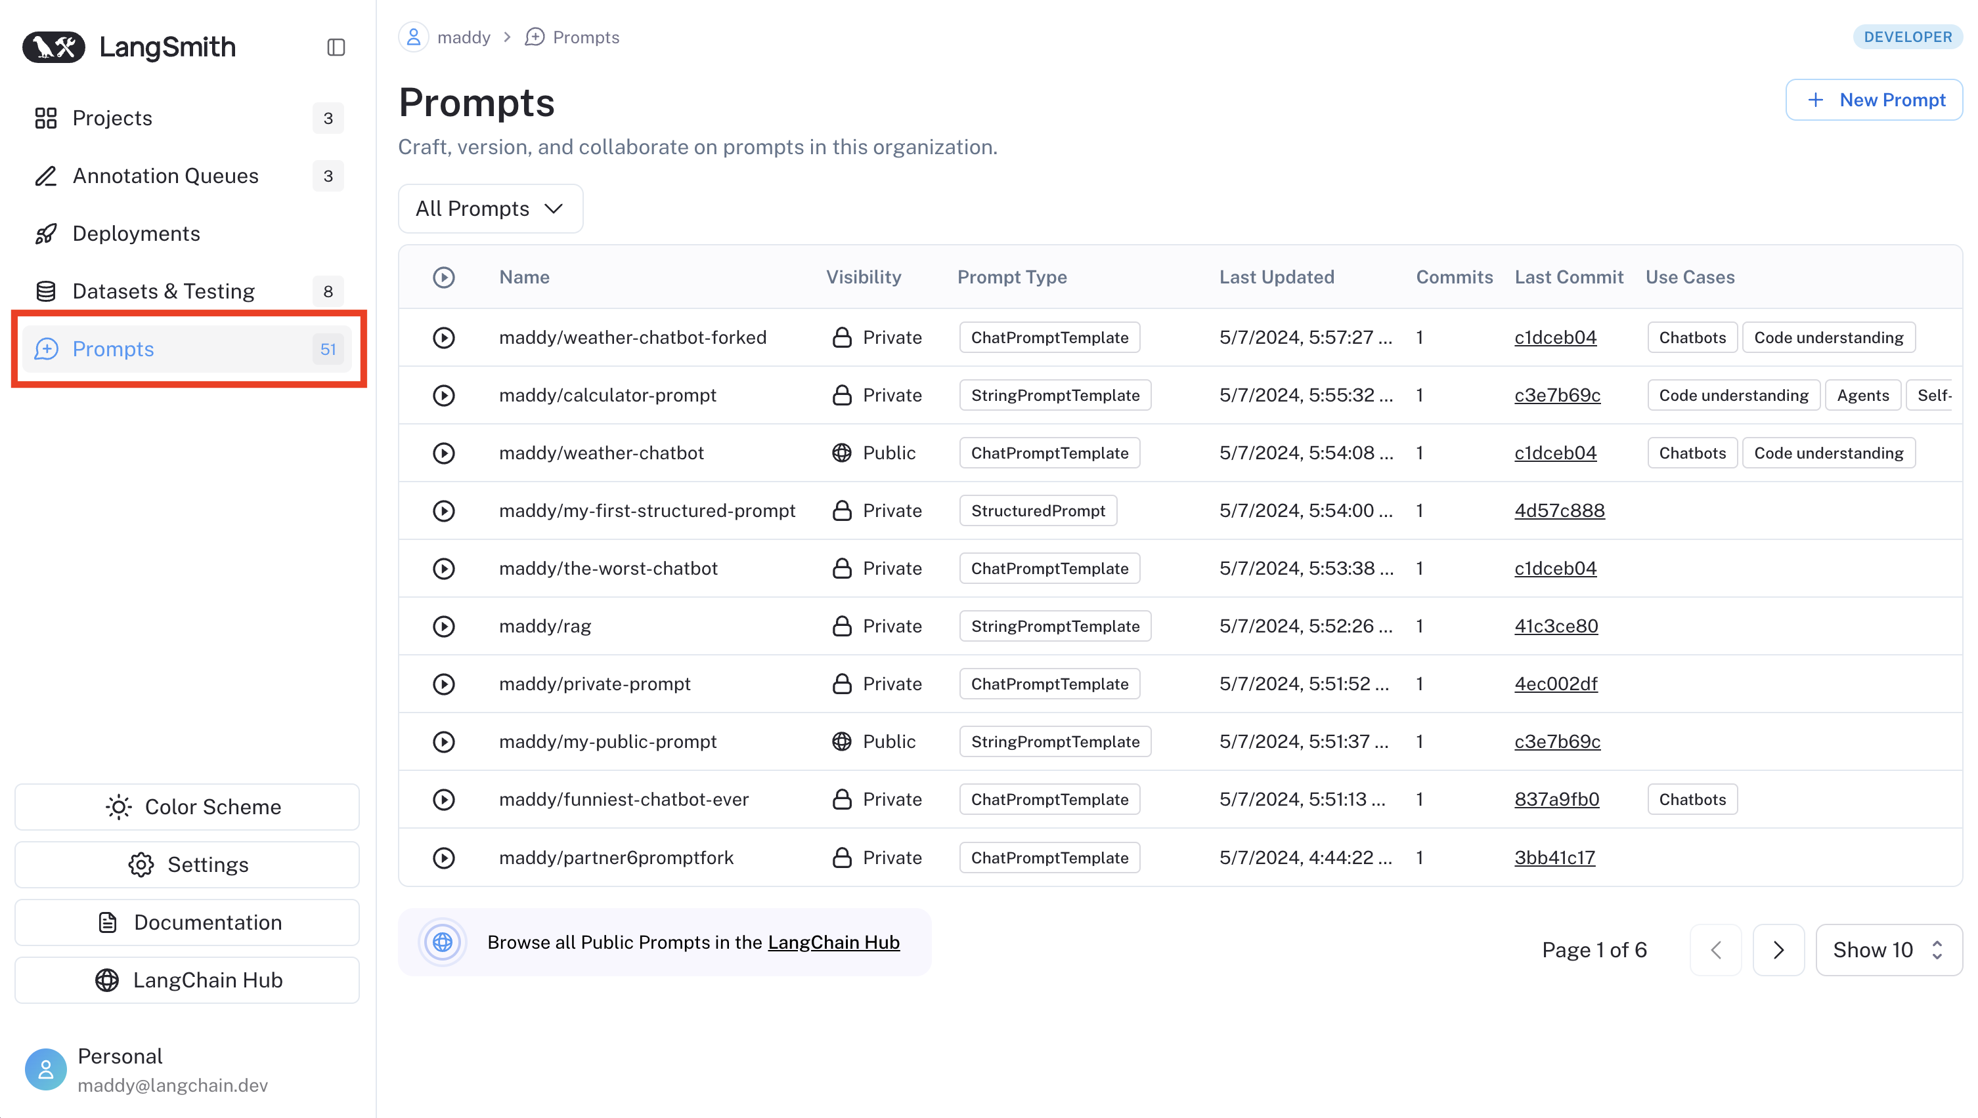
PromptOps
2. Prompt Registry & Versioning
Use tools like LangSmith, PromptLayer, or TruLens, mlflow, langfuse.
Store:
Prompt ID
Author
Version History
Purpose and Model Target
Associated Test Cases

Slide 79
PromptOps
3. Prompt Testing
Define expected outputs for each prompt.
Automate tests with CI tools like GitHub Actions or Jenkins.
Include:
Validations (Does it answer correctly?)
Performance metrics (latency, cost)
Toxicity/fairness checks

Slide 80
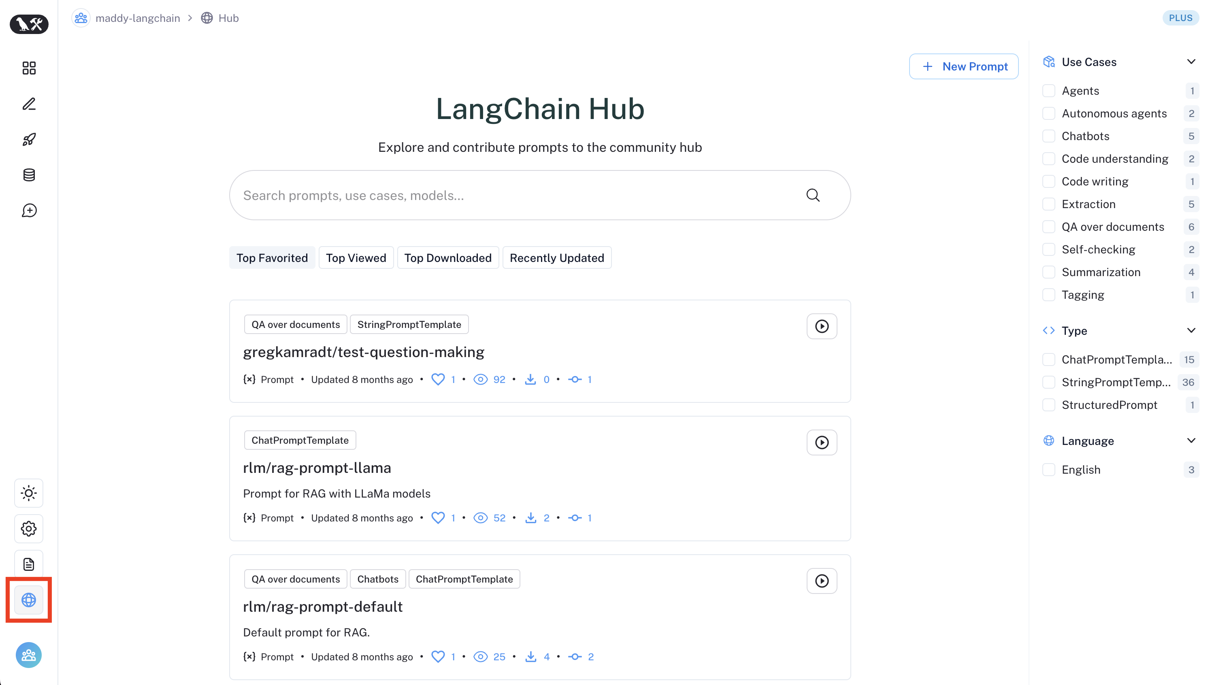
PromptOps
4. Prompt Deployment
Register prompts in a prompt catalog (via API or UI).
Serve via central orchestration (LangChain, FastAPI backend).
Auto-inject contextual metadata (e.g., user profile, machine state)

Slide 81
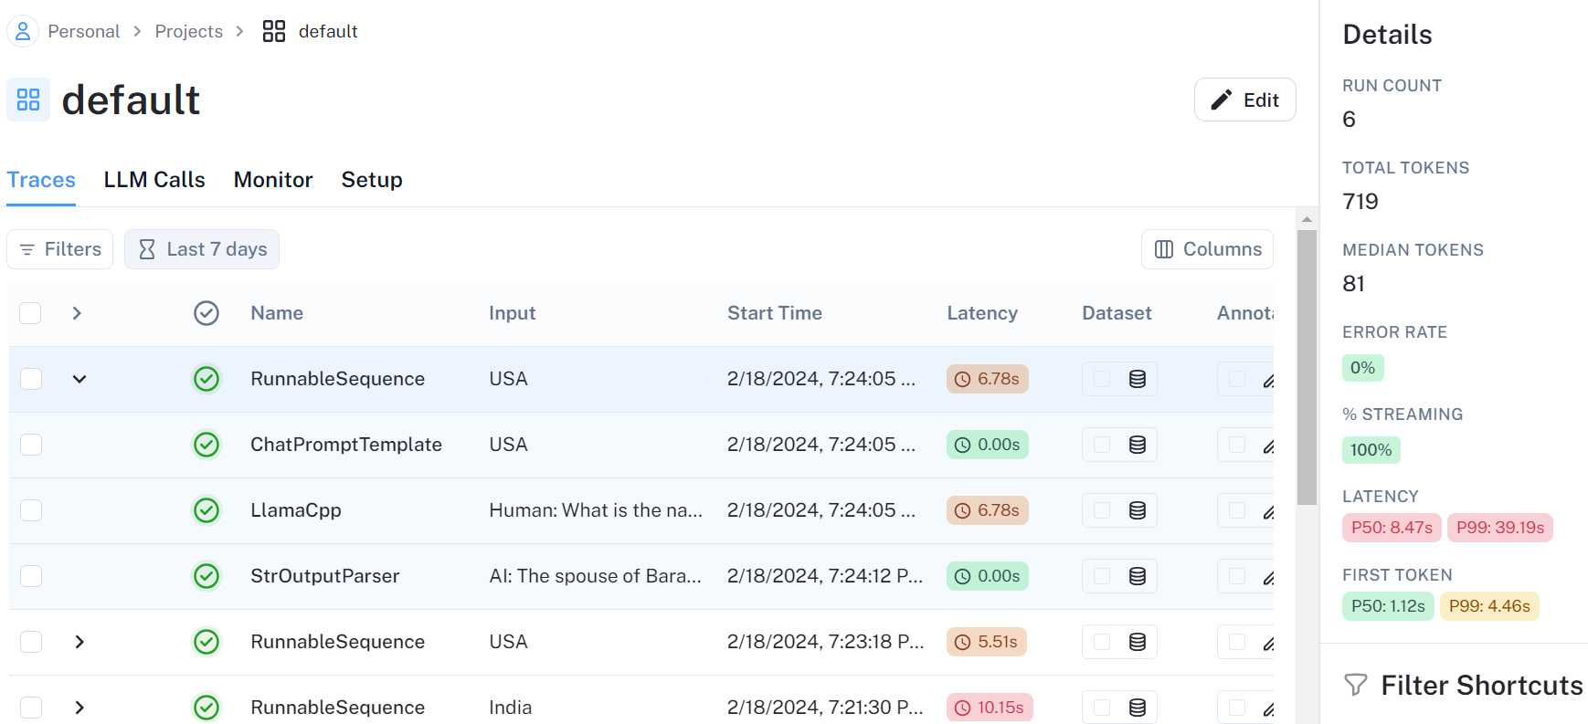
PromptOps
5. Prompt Observability
Track:
Prompt frequency
Token usage and cost
User feedback ratings
Latency
Use: LangSmith dashboards, OpenObserve, or Weights & Biases integrations.

Slide 82
Prompt Engineering
Persona: you are an expert senior legal document analyst
Instruction: CCS (clear, concise, specific) -> start with action word, make it one liner: Summarize the below content
Context/Background:
Format: output format: file specific format (CSV, JSON, XML), content specific format: bullet points, tables
Constraint: Boundaries the LLM has to follow

Slide 83
PromptOps Practices
Phase | Technique | Details
Design | Few-shot prompting | Added examples of past root cause/fix summaries
Testing | Regression testing | 20 test scenarios across machine types
Versioning | Git-integrated prompt registry | Engineers commit prompt templates to Git, tagged with use case and LLM target
Deployment | API wrapper | Prompt wrapped in a FastAPI endpoint used by factory dashboard UI
Observability | LangSmith + Logging | Tracked accuracy, cost per query, fallback rates to traditional troubleshooting tree

Slide 84
Cheatsheets

Slide 85
Enterprise Generative AI Architecture

Slide 86

GenAI Application Pattern
🎯 Prompt-Based Solution
🔗 Chain-Based Automation
🤖 Agentic AI Solution
📚 RAG (Retrieval-Augmented Generation)
🎓 Fine-Tuning LLM
Best for: Simple, single-step tasks
Best for: Multi-step processes with fixed sequence
Best for: Dynamic, autonomous decision-making
Best for: Dynamic knowledge that changes frequently
Best for: Static, specialized domain expertise
Use when:
Direct input → output (translation, summarization, classification)
No intermediate processing needed
Quick prototyping or MVP development
Use when:
Deterministic business workflows
Each step depends on the previous one
Predictable sequence of operations
Use when:
Non-deterministic processes
Need planning and reasoning capabilities
Tool usage and external API integration required
Use when:
External knowledge base needed
Information updates regularly
Context-aware responses required
Use when:
Deep domain-specific knowledge required
Specialized terminology and jargon
Knowledge rarely changes
Examples: Text translation, email drafting, content summarization
Examples: Document processing pipeline, data extraction → validation → formatting
Examples: Research assistants, adaptive workflow automation, complex problem-solving
Examples: Customer support, document Q&A, policy inquiries
Examples: Medical diagnosis, legal document analysis, technical writing
Implementation: Direct API calls to LLM providers (OpenAI, Azure OpenAI)
Frameworks: LangChain, LangGraph, AutoGen
Frameworks: AutoGen, LangGraph Agents, CrewAI
Components: Vector database + Embeddings + LLM
Requirements: Significant compute resources and training data

Slide 87
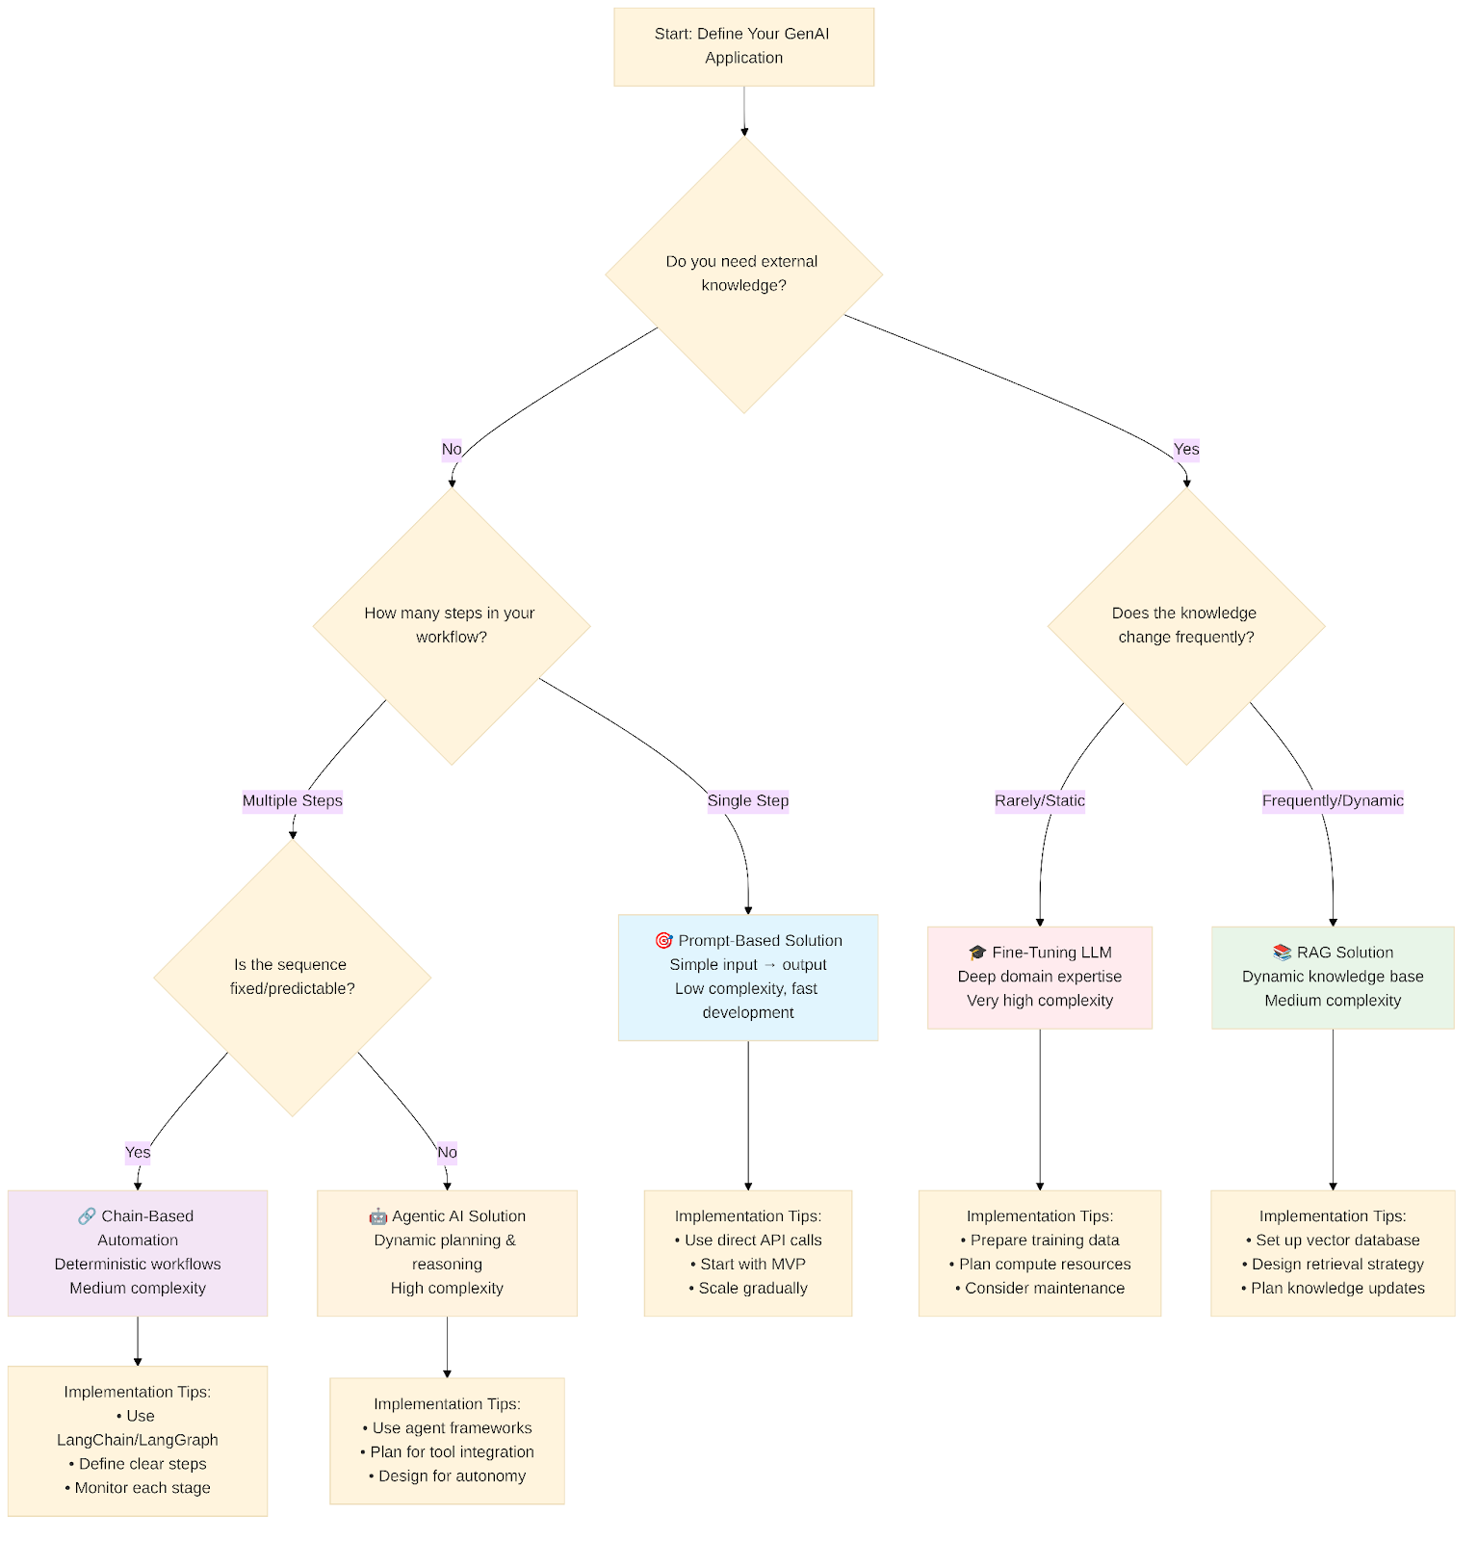
GenAI Application Pattern

Slide 88
GenAI Application Pattern
Pattern | Development Complexity | Update Effort | Latency | Cost
Prompt-Based | ⭐ Very Low | ⭐ None | ⭐ Very Low | ⭐ Low
Chain Automation | ⭐⭐ Low-Medium | ⭐⭐ Moderate | ⭐ Low | ⭐⭐ Medium
RAG | ⭐⭐⭐ Medium | ⭐ Low | ⭐⭐ Medium | ⭐⭐ Medium
Agentic AI | ⭐⭐⭐⭐ Medium-High | ⭐⭐⭐ High | ⭐⭐ Medium | ⭐⭐⭐ High
Fine-Tuning | ⭐⭐⭐⭐⭐ Very High | ⭐⭐⭐⭐⭐ Very High | ⭐⭐ Low-Medium | ⭐⭐⭐⭐⭐ Very High

